Slide 1
Lecture 1 Introduction to Artificial Intelligence
CS 180 – Intelligent Systems
Dr. Victor Chen
Fall 2022

Slide 2
Overview
What is AI?
AI history
AI Applications
Smart Agent
PEAS model

Slide 3
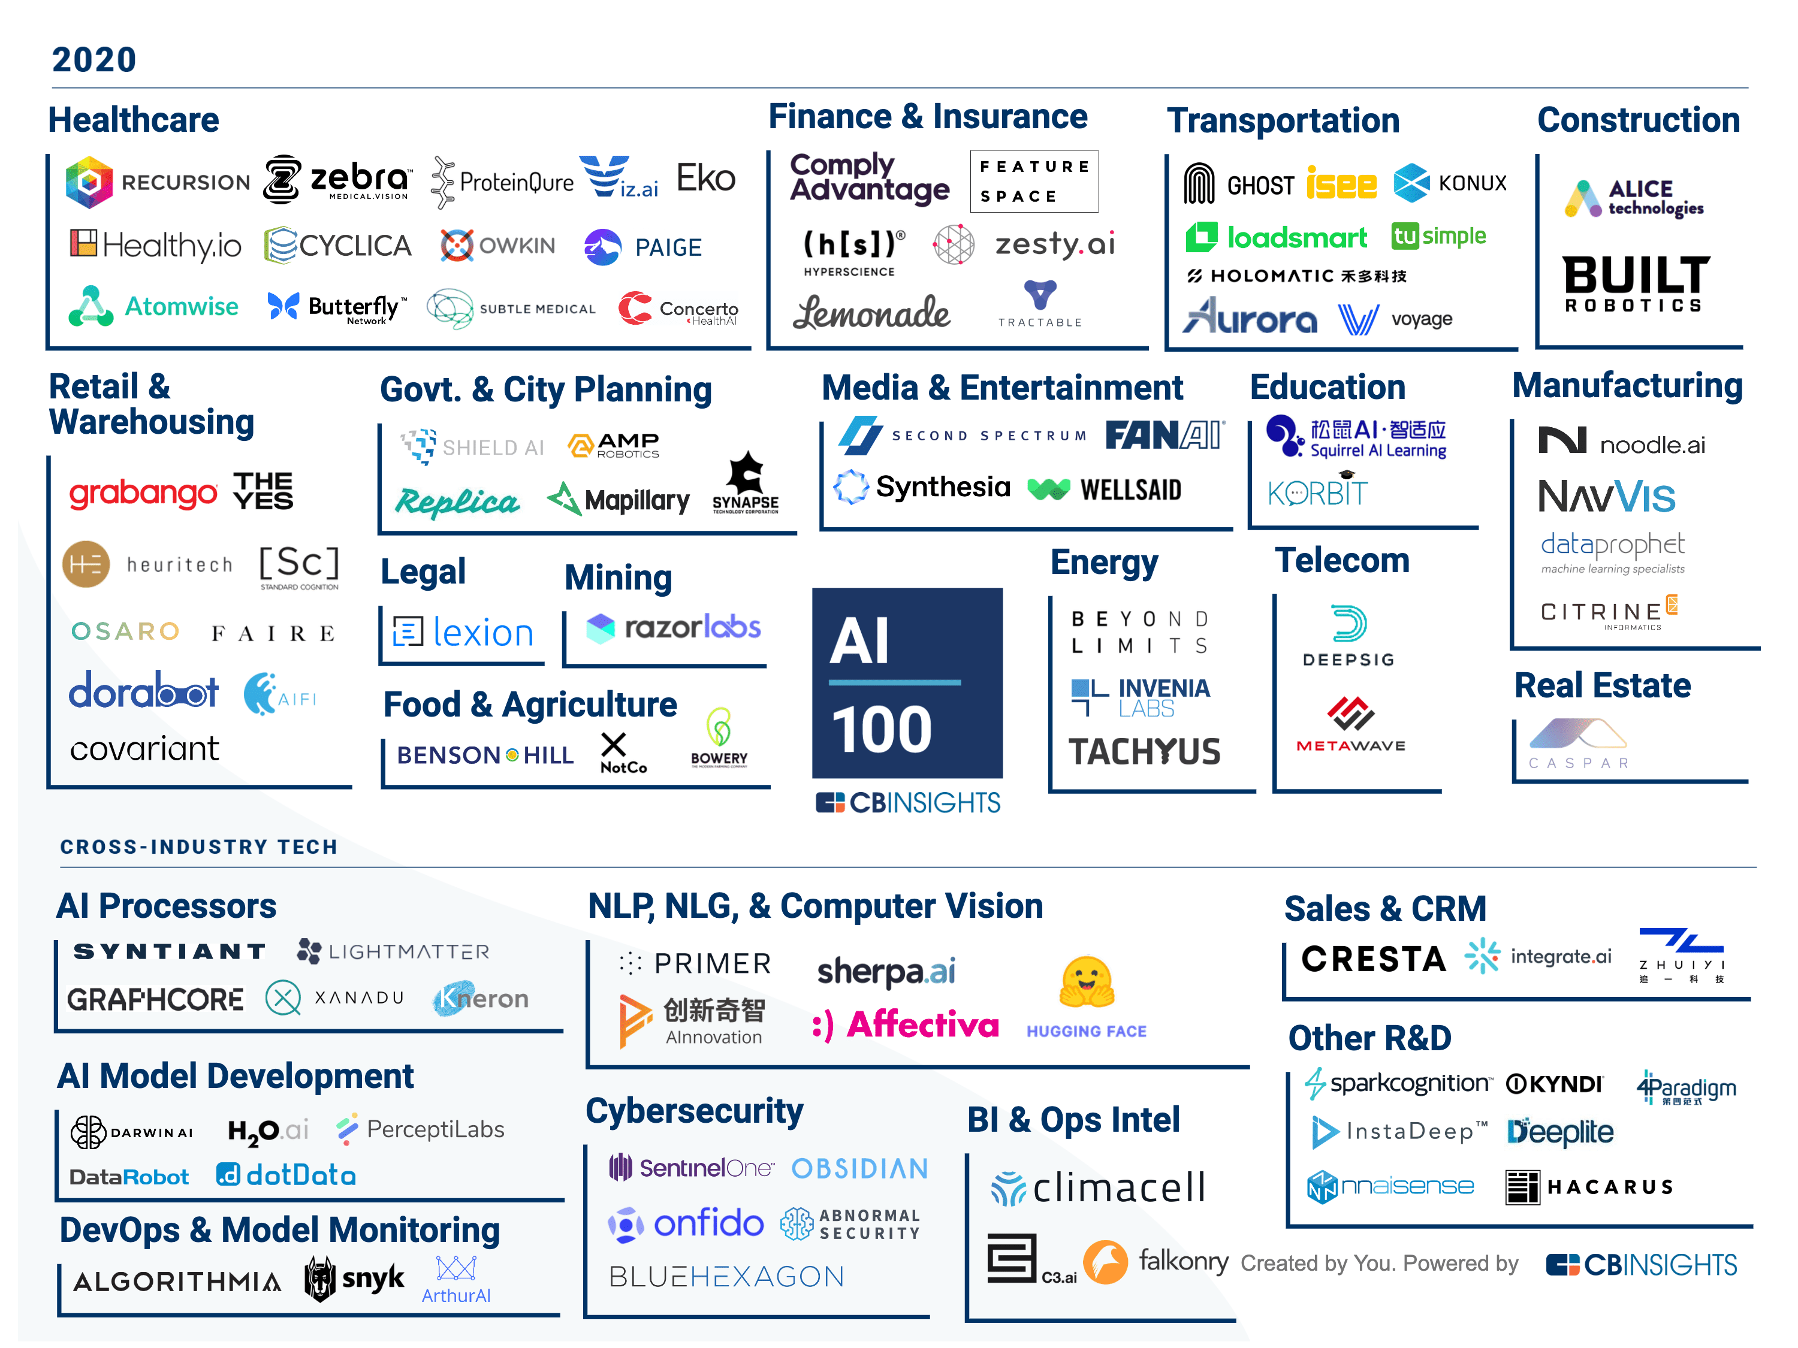
100 most promising AI startups redefining industries
https://www.cbinsights.com/research/artificial-intelligence-top-startups/

Slide 4
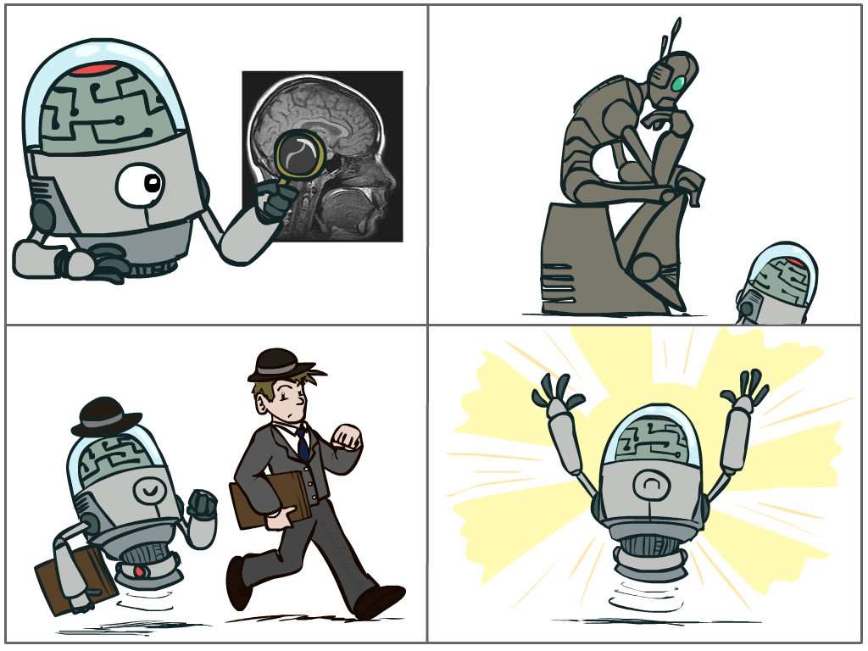
What is AI ?
A study on how to program computers to solve hard problems that traditionally require human intelligence to solve
Thinking humanly
Acting humanly
Thinking rationally
Acting rationally

Slide 5
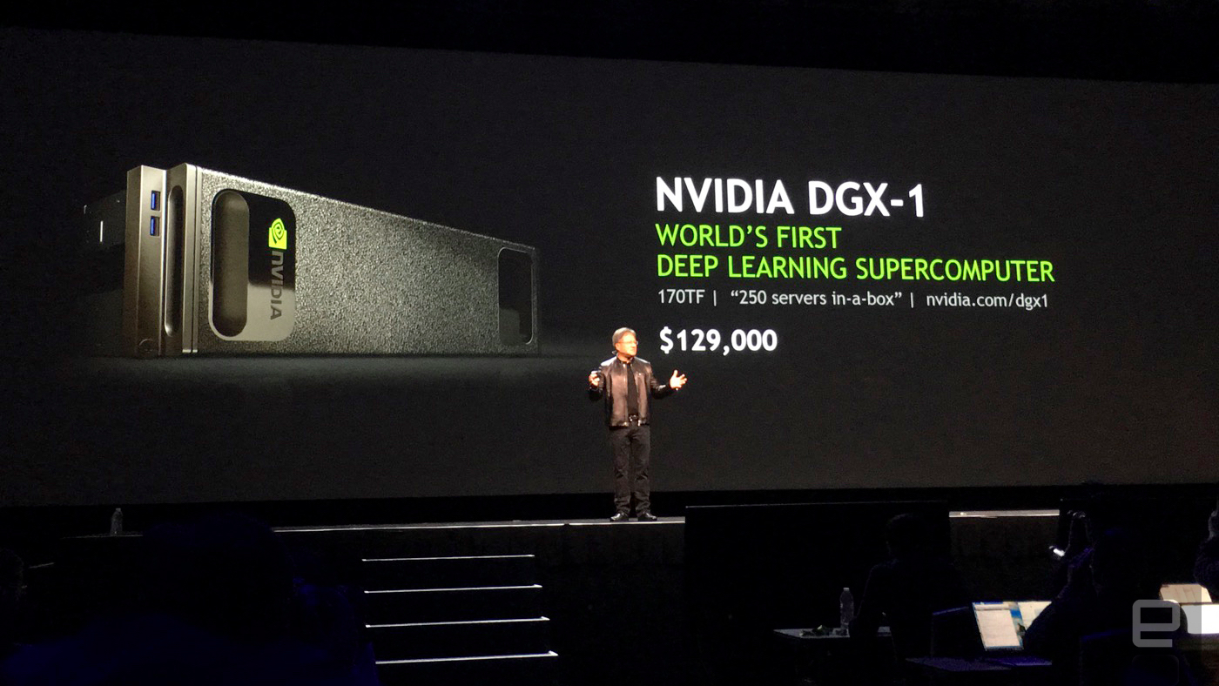
History of AI to the present day
1980s Expert systems boom
Late 1980s Expert system bust; the AI winter
Mid-1980s Neural networks, backpropagation
Late 1980s Uncertain/Probabilistic knowledge reasoning
1990s Machine learning becomes dominant, begins to flourish
Late 2000s Big data come to the stage
2010s Deep learning started to flourish everywhere
New industry boom

Slide 6
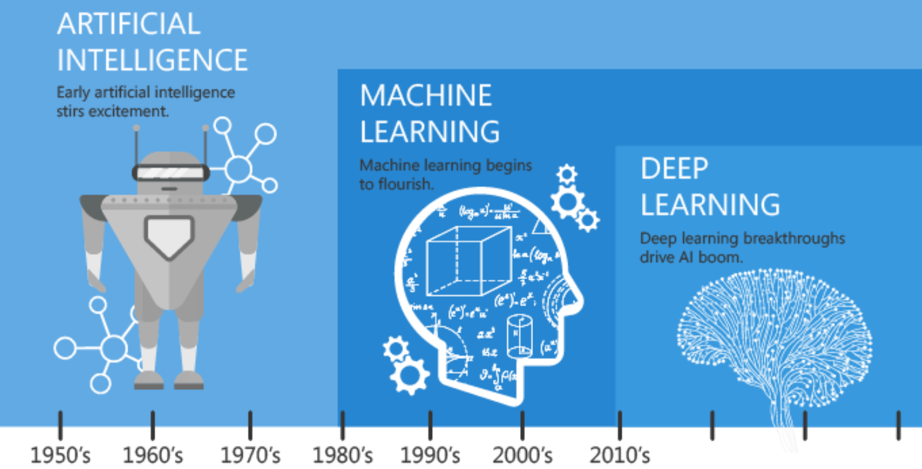

Slide 7
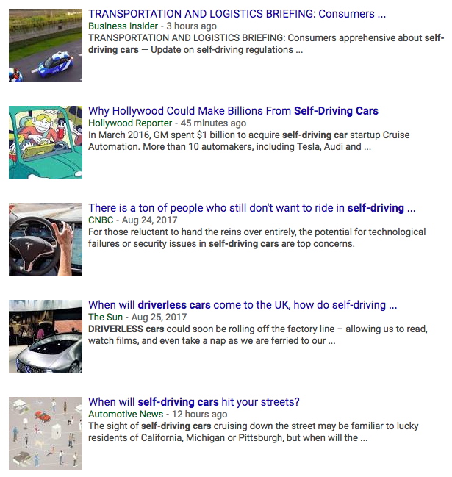
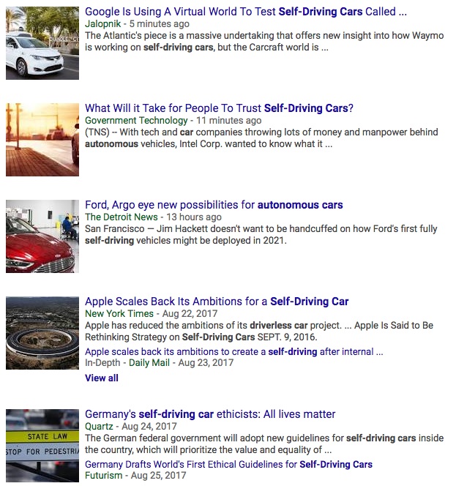
AI Applications: Self-driving cars
Video: A ride in a Waymo driverless car

Slide 8
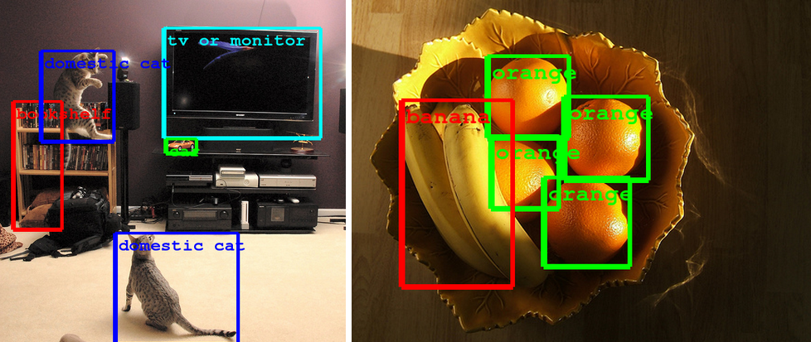
AI Applications: Computer Vision
Computer Eyesight Gets a Lot More Accurate, NY Times Bits blog, August 18, 2014

Slide 9
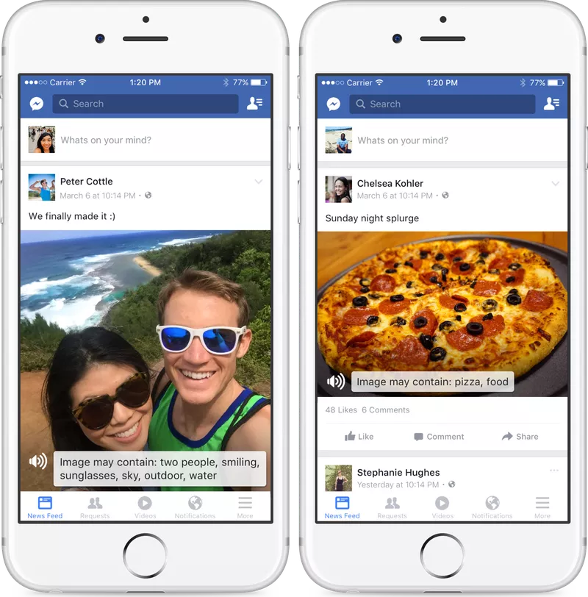
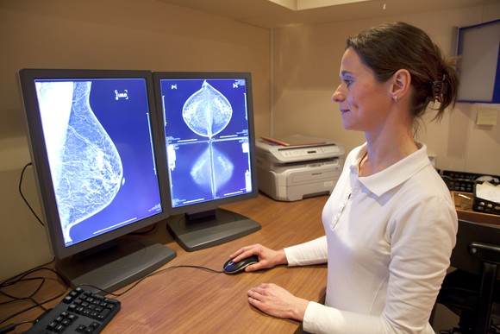
AI Applications: Computer Vision
AI beats human pathologists at detecting cancer/tumor
Facebook accessibility tools for the visually impaired (convert images to captions)

Slide 10
AI Applications: Computer Vision
https://thing-translator.appspot.com/
https://quickdraw.withgoogle.com/
https://modeldepot.github.io/tfjs-yolo-tiny-demo/
https://experiments.withgoogle.com/imaginary-soundscape

Slide 11
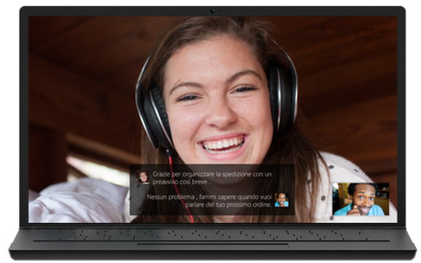
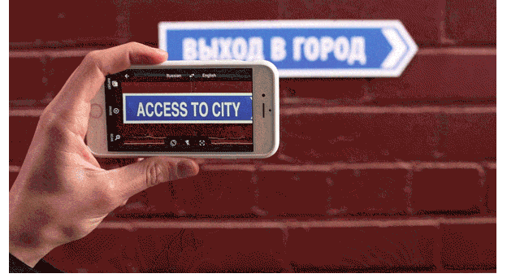

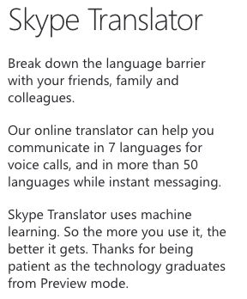
AI Applications: Speech and natural language
Google Translate App
Translate between 103 languages by typing
Offline: Translate 52 languages when you have no Internet
Instant camera translation: Use your camera to translate text instantly in 30 languages
Camera Mode: Take pictures of text for higher-quality translations in 37 languages
Conversation Mode: Two-way instant speech translation in 32 languages
Handwriting: Draw characters instead of using the keyboard in 93 languages
https://www.skype.com/en/features/skype-translator/
https://play.google.com/store/apps/details?id=com.google.android.apps.translate&hl=en

Slide 12
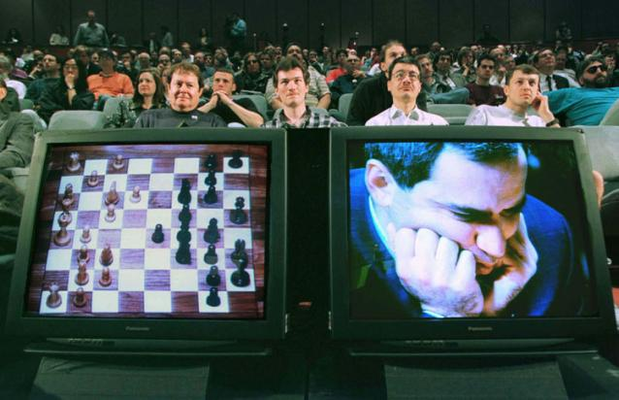
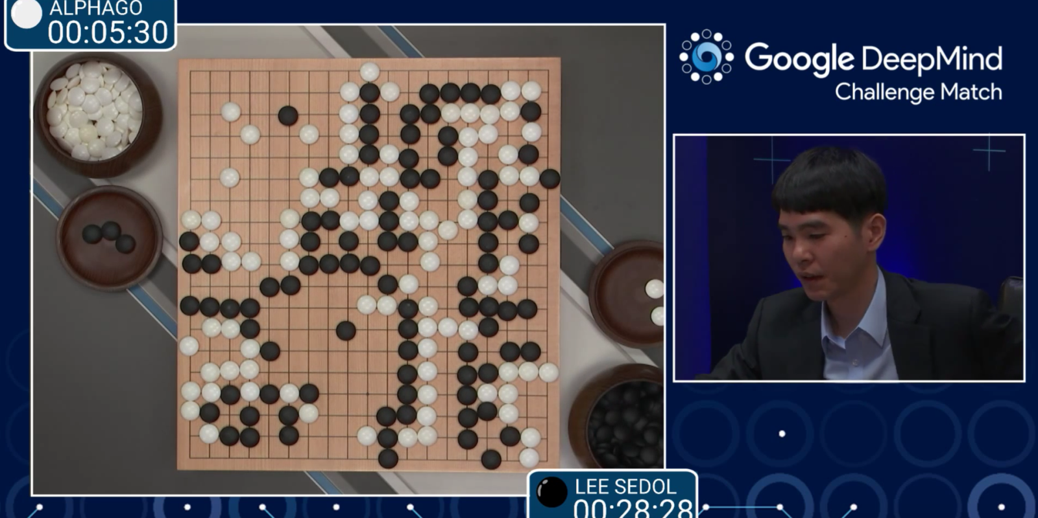
AI Applications: Games
1997: IBM’s Deep Blue defeats the reigning world chess champion Garry Kasparov
1997: Deep Blue Beats Kasparov
2007: Checkers is solved
AI programs have been beating the best humans
2016: AlphaGo won against Go grandmaster Lee Sedol 4-1
2017: CMU’s AI system beat the best human players at no-limit Texas Hold’em poker

Slide 13
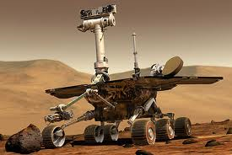
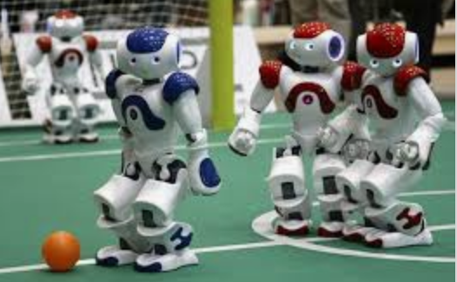
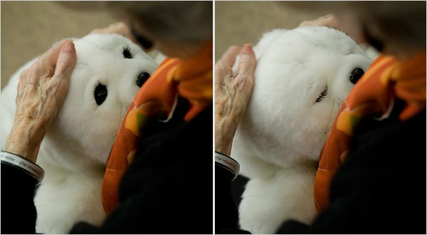
AI Applications: Robotics
Autonomous vehicles
Vehicles for exploring space, hazardous environments
Autonomous drones
Soccer robots
RoboCup
Personal robots
Humanoid robots
Robotic pets
Personal assistants?

Slide 14
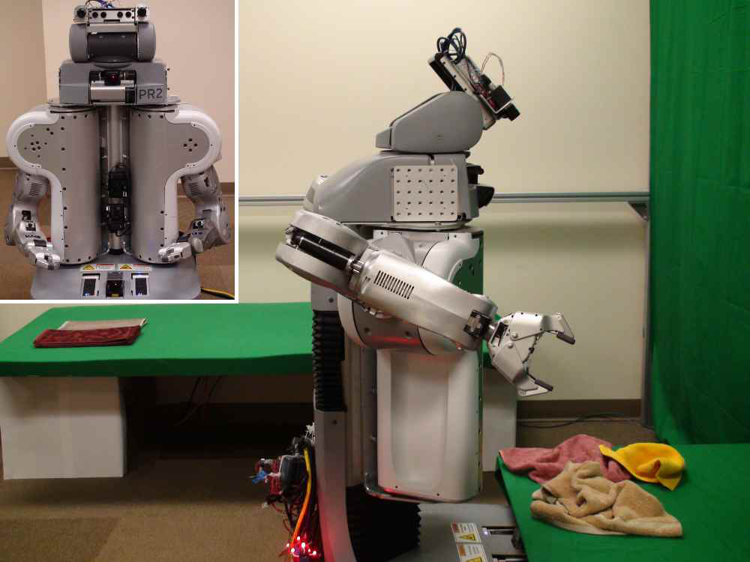
Towel-folding robot
YouTube Video
J. Maitin-Shepard, M. Cusumano-Towner, J. Lei and P. Abbeel, Cloth Grasp Point Detection based on Multiple-View Geometric Cues with Application to Robotic Towel Folding, ICRA 2010

Slide 15
Focus of this class
We will learn not only AI techniques but also how to implement them using popular Python AI packages.
Thus, this class is a class emphasizing both theory and hands-on

Slide 16
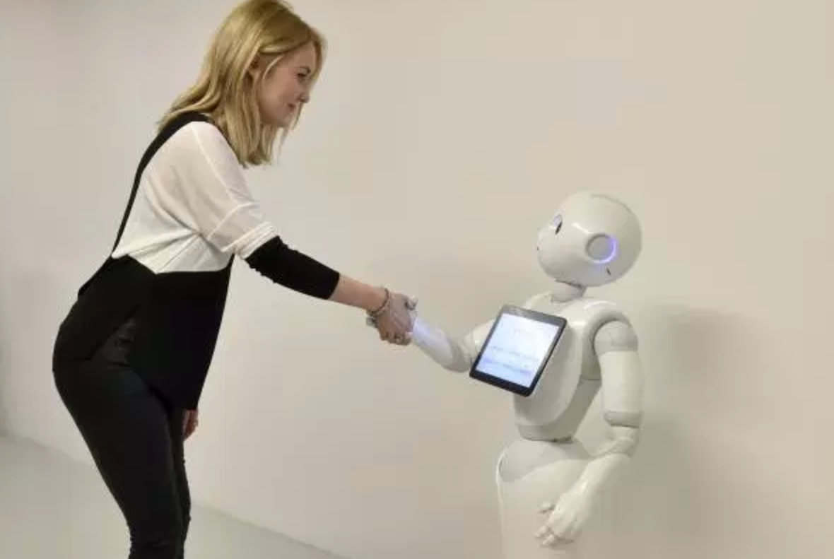
Smart Agent

Slide 17
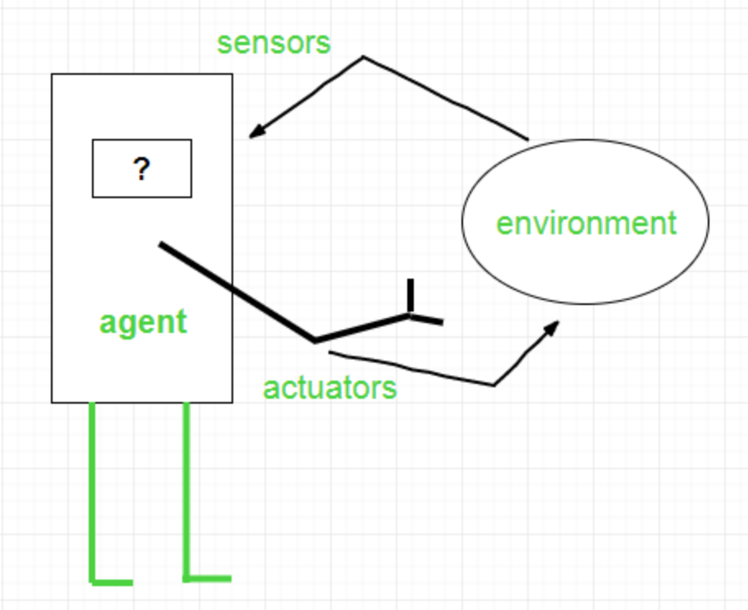
Agents
An agent is a software which observes input through sensors and acts upon an environment using actuators

Slide 18
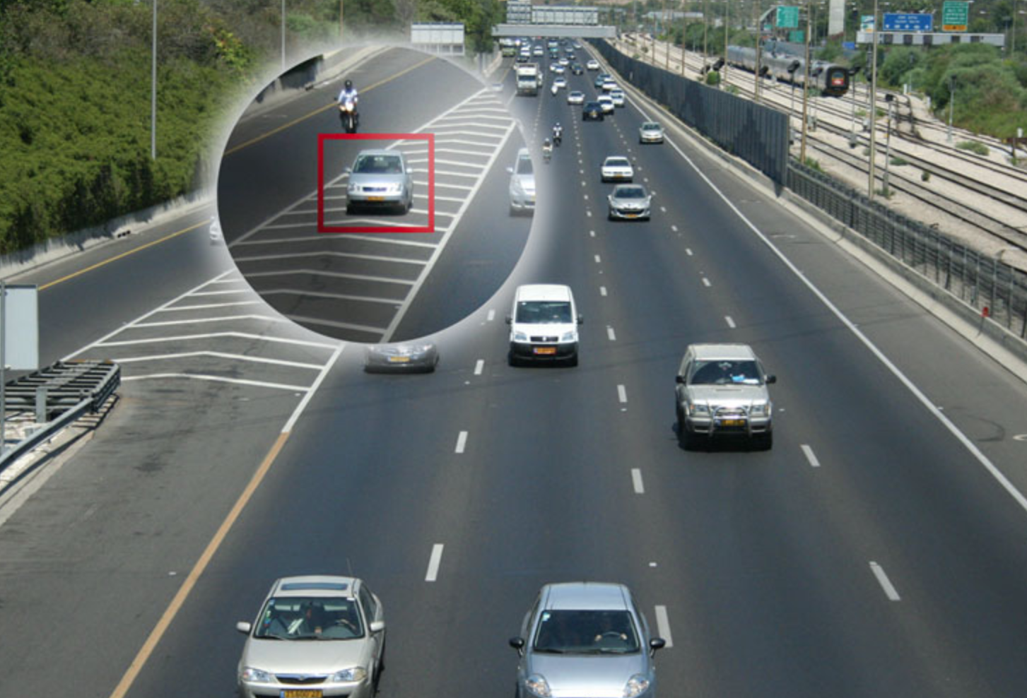
Smart agents
Given input from sensor, a smart agent should take an action that will maximize its performance measure.
Performance measure: utility objective function:

Slide 19
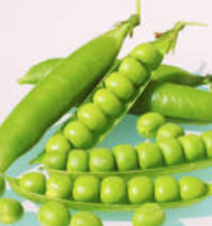
PEAS model: on which most of AI agents work upon
PEAS: Performance measure, Environment states, Actuators, Sensors
P: an objective function the agent is maximizing (or minimizing)
E: a formal representation for states
A state = a group of variables
= a tuple of (var₁=val₁, var₂=val₂, … ,var_{n}=val_{n})
A: actions that change the agent state according to a transition model
S: observations that allow the agent to infer the world state

Slide 20
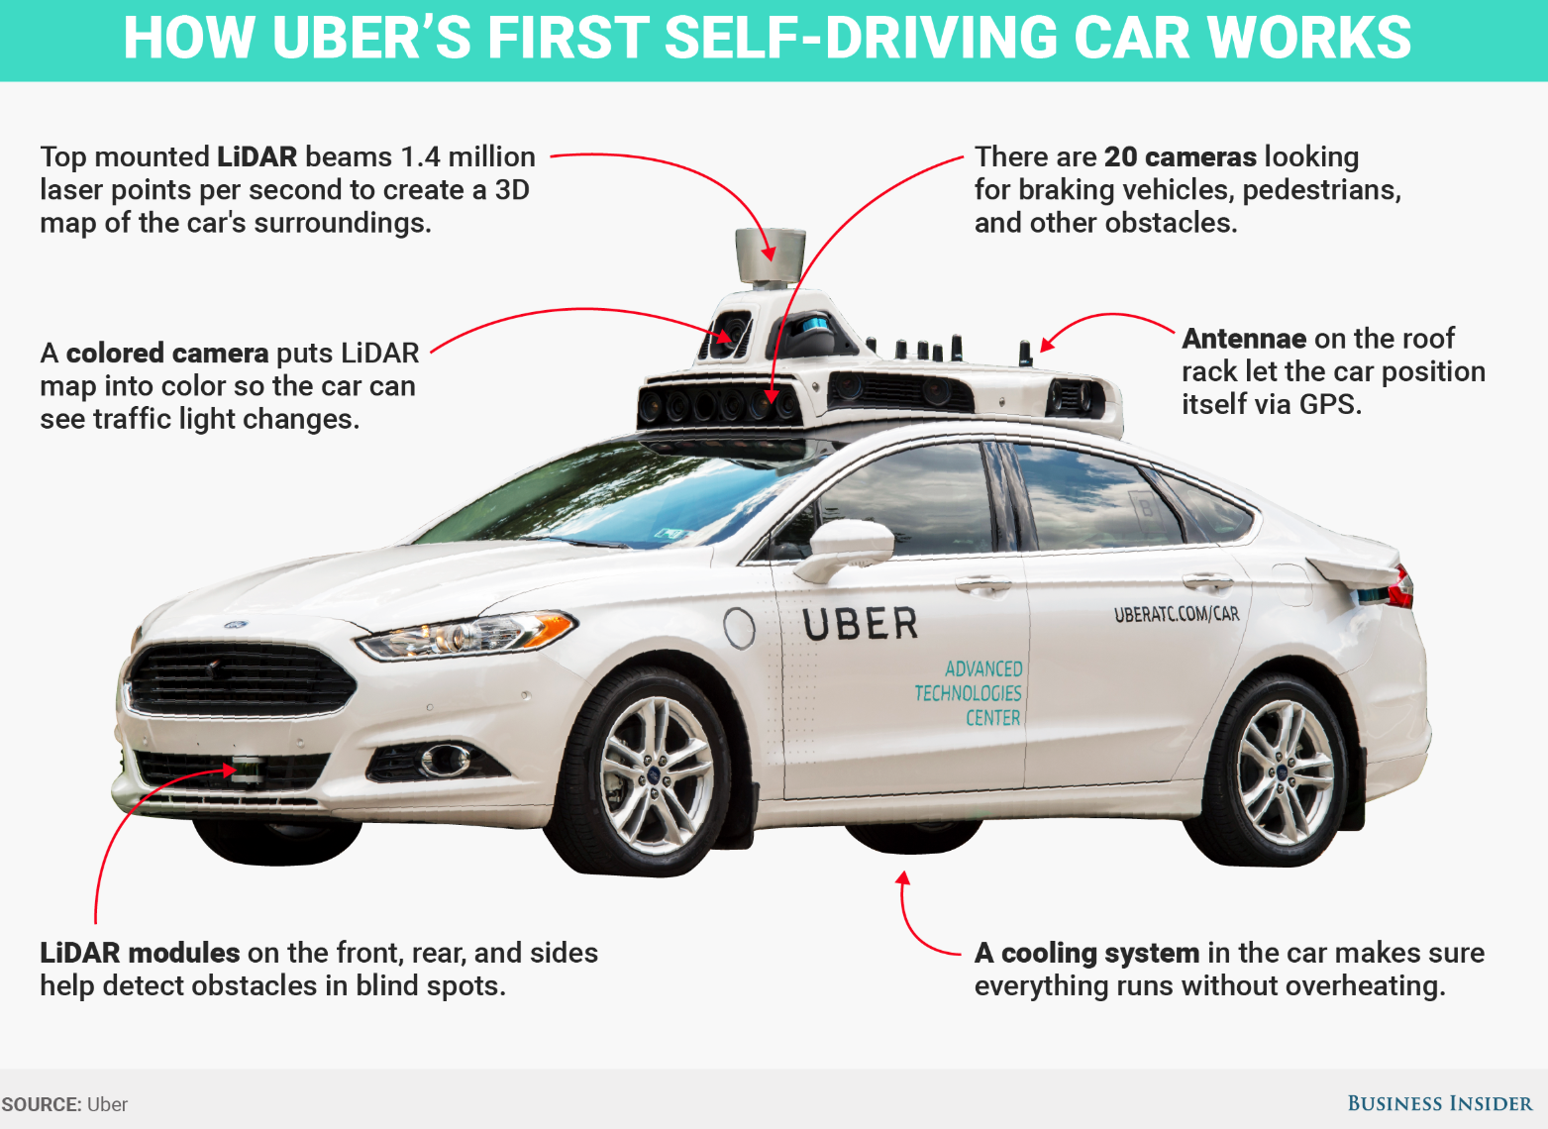
PEAS Example: Autonomous taxi
Performance measure
function for a safe, fast, legal, comfortable trip
Environment states
Roads, traffic, pedestrians
Actuators
Steering wheels, engine, brake, signal,
Sensors
Cameras, LIDAR, speedometer, GPS, odometer, engine sensors, keyboard

Slide 21
Another PEAS example: Email spam filter
Performance measure
Minimizing false positives, false negatives
Environment states
A user’s email account, email server
Actuators
Mark as spam, delete, etc.
Sensors
Incoming messages, other information about user’s account

Slide 22

Video
What AI can do today?

Slide 23
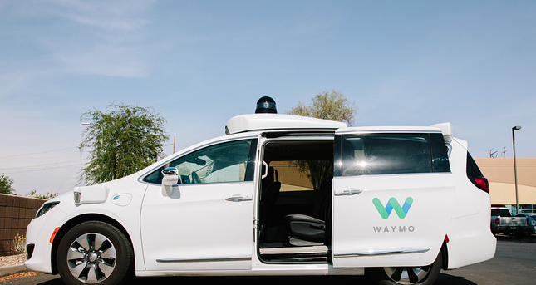
Video
Waymo (Google) self-driving cars get green light to carry passengers in California

Slide 24
Lecture 2 Data Preprocessing and Model Evaluation
CS 180 – Intelligent Systems
Dr. Victor Chen
Fall 2022

Slide 25
Data Preprocessing

Slide 26
What is Data?
Attributes
Data include objects and their attributes
An object means an entity in the world
Examples: person, transaction, image
Object is also known as record, point, sample, or instance
An attribute is a property of an object
Examples: name, date of birth, height, occupation are attributes of person.
Attribute is also known as field, or feature
Objects

Slide 27
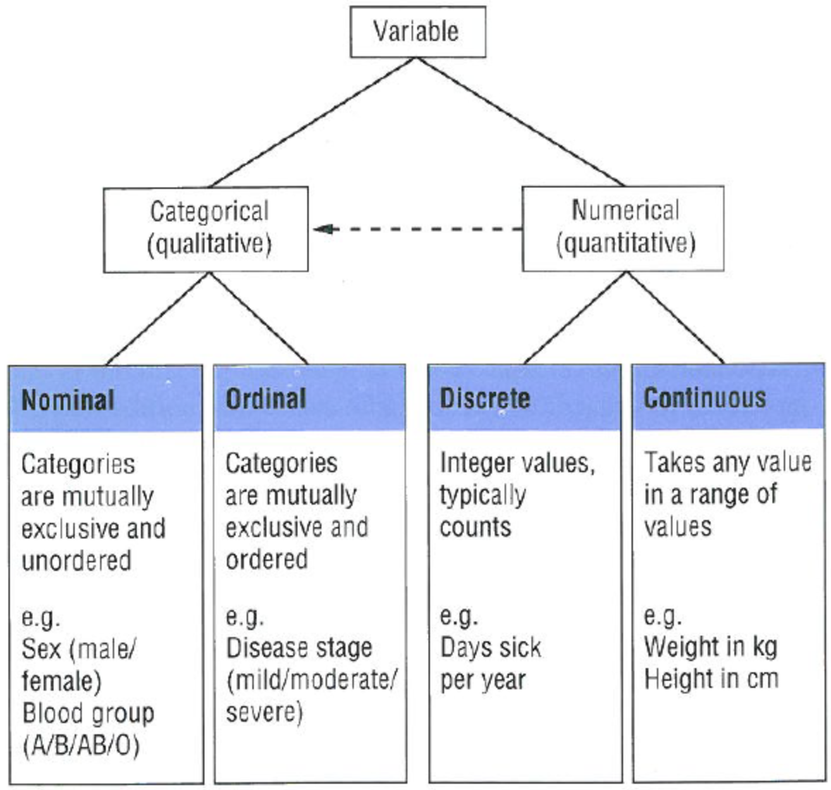
Numeric and Categorical Data
Attributes can be:
Numeric
Examples: dates, temperature, time, length
Discrete vs Continuous
Categorical
Examples: eye color, rankings (e.g, good, fair, bad), height in {tall, medium, short}
Nominal (no order) vs Ordinal (ordered but not comparable)

Slide 28
If an attribute is categorical….

Slide 29
Data Encoding
If an attribute is categorical, we must convert it from categorical to numeric.
ID Number | Zip Code | Age | Marital Status | Income | Income Bracket | Refund
1129842 | 45221 | 55 | Single | 250000 | High | No
2342345 | 45223 | 25 | Married | 30000 | Low | Yes
1234542 | 45221 | 45 | Divorced | 200000 | High | No
1243535 | 45224 | 43 | Single | 150000 | Medium | No

Slide 30
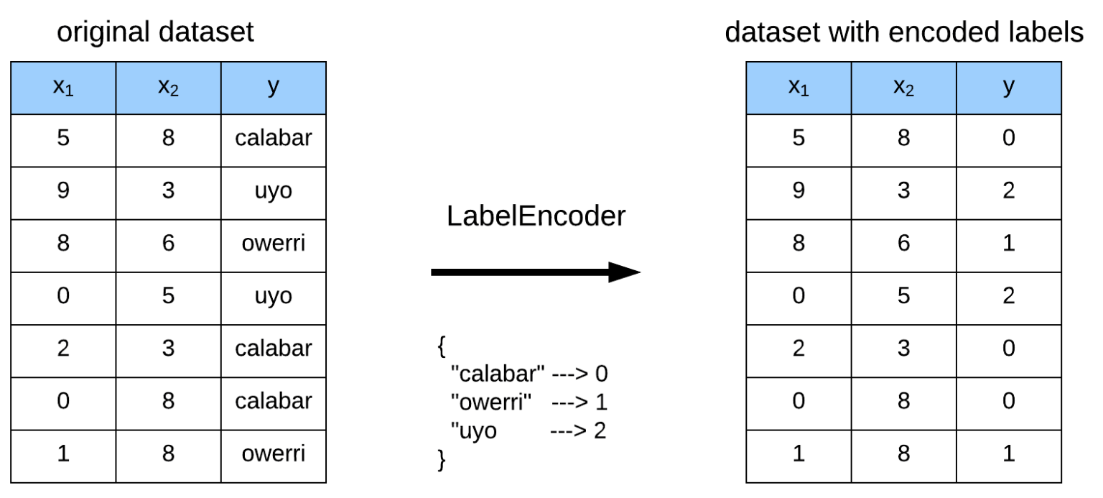
Label Encoding
Label Encoding: Assign one unique number to each distinct value

Slide 31

Never use label encoding on input features

Slide 32
Data Encoding
How to convert the feature “Zip Code” from categorical to numeric?
ID Number | Zip Code | Age | Marital Status | Income | Income Bracket | Refund
1129842 | 45221 | 55 | Single | 250000 | High | No
2342345 | 45223 | 25 | Married | 30000 | Low | Yes
1234542 | 45221 | 45 | Divorced | 200000 | High | No
1243535 | 45224 | 43 | Single | 150000 | Medium | No

Slide 33
Data Encoding
One hot Encoding: For each distinct value, we create a new binary feature
ID | Zip 45221 | Zip 45223 | Zip 45224 | Age | Single | Married | Divorced | Income | Refund
1129842 | 1 | 0 | 0 | 55 | 1 | 0 | 0 | 250000 | 0
2342345 | 0 | 1 | 0 | 25 | 0 | 1 | 0 | 30000 | 1
1234542 | 1 | 0 | 0 | 45 | 0 | 0 | 1 | 200000 | 0
1243535 | 0 | 0 | 1 | 43 | 1 | 0 | 0 | 150000 | 0
Thinking of records as vectors is very useful, which allows us to use linear algebra to process data.

Slide 34
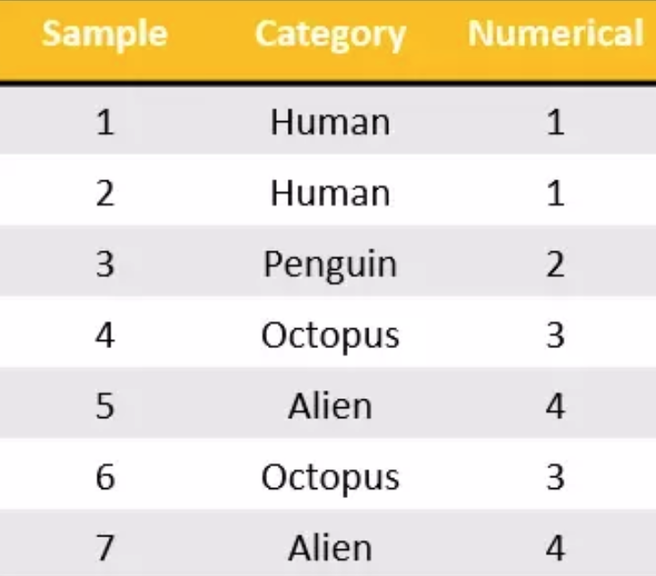
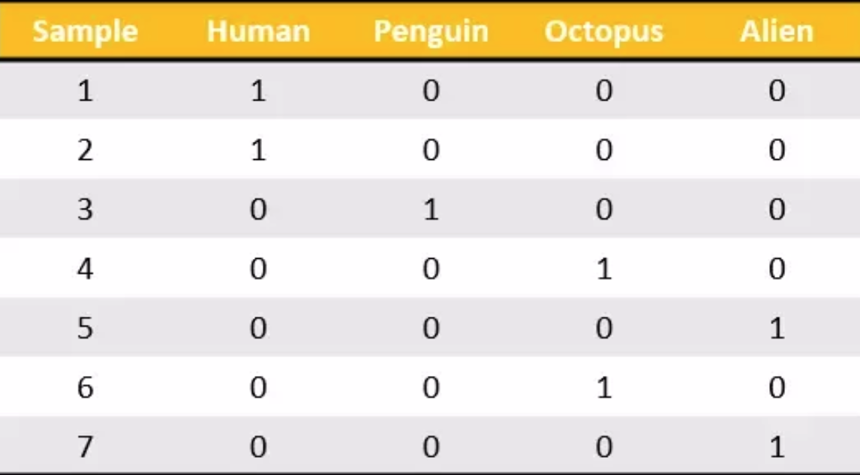
Another example: One hot encoding

Slide 35
If an attribute is numeric….

Slide 36
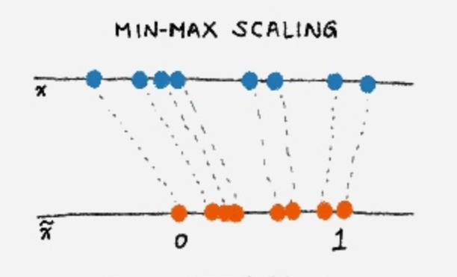
Data normalization
If an attribute is numeric, we must normalize that attribute rather than using raw values

Slide 37
Normalization on numeric data
Different attributes take very different range of values.
We need to make them comparable
Temperature | Humidity | Pressure
30 | 0.8 | 90
32 | 0.5 | 80
24 | 0.3 | 95

Slide 38
Normalization – option 1
Divide raw values by the maximum value
Brings everything in the [0,1] range
Temperature | Humidity | Pressure
0.9375 | 1 | 0.9473
1 | 0.625 | 0.8421
0.75 | 0.375 | 1
new value = old value / max value in the column
Temperature | Humidity | Pressure
30 | 0.8 | 90
32 | 0.5 | 80
24 | 0.3 | 95

Slide 39
Normalization --- option 2
Subtract the minimum value and divide by the difference of maximum value and minimum value
Brings everything in the [0,1] range
Temperature | Humidity | Pressure
0.75 | 1 | 0.33
1 | 0.6 | 0
0 | 0 | 1
new value = (raw value – min column value) / (max col. value –min col. value)
Temperature | Humidity | Pressure
30 | 0.8 | 90
32 | 0.5 | 80
24 | 0.3 | 95

Slide 40
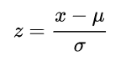
Normalization --- option 3
The standard score, z, of a raw value x is
where:
μ is the mean.
σ is the standard deviation.
Standard scores are also called z-scores
z score is negative when the raw value is below the mean, positive when above

Slide 41
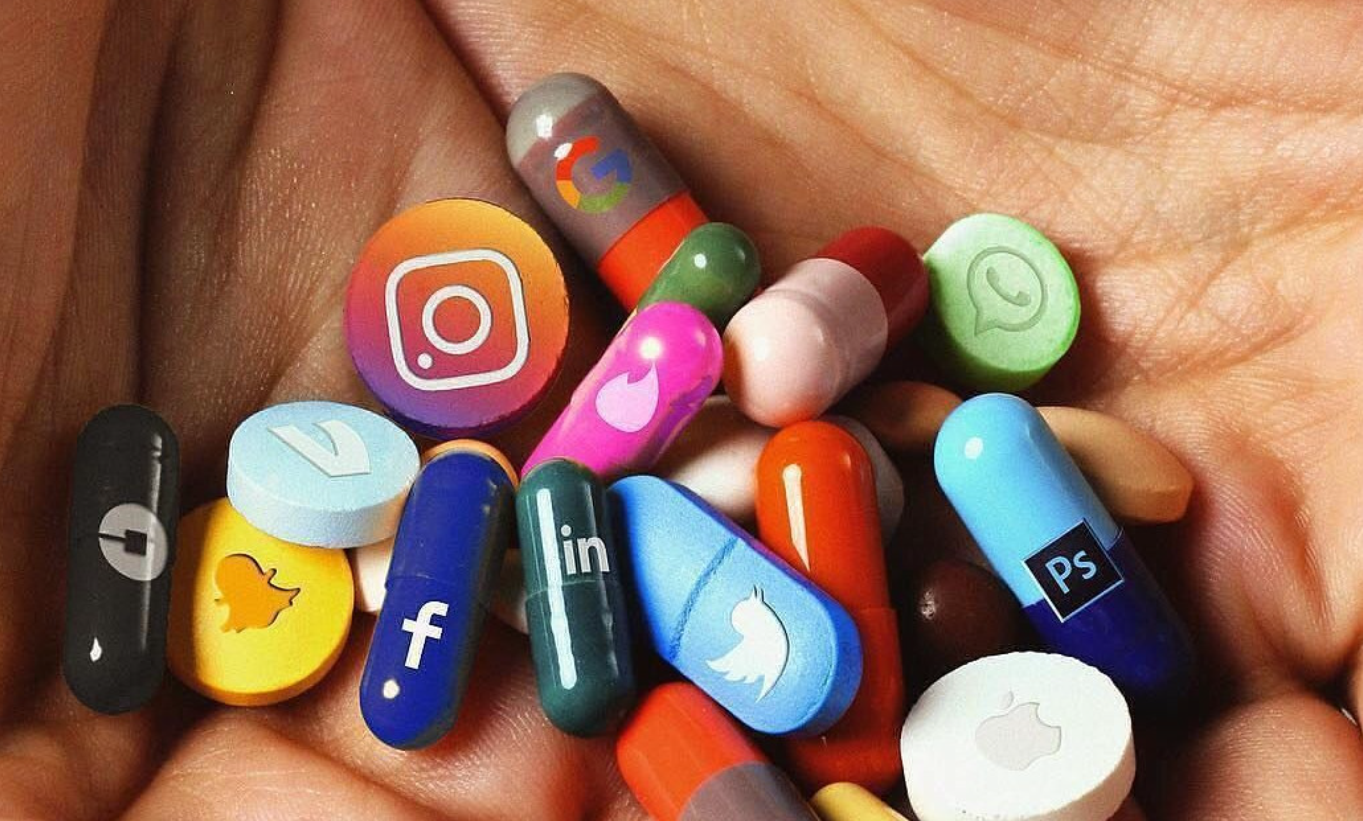

Natural Language Processing

Slide 42
Overview
Bag-of-words (BoW) model
TF-IDF model

Slide 43
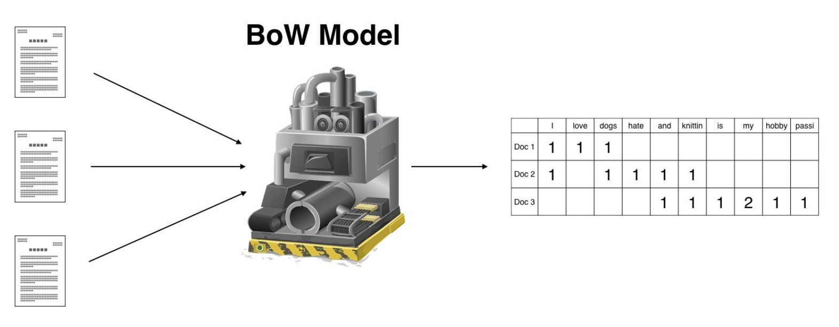

Slide 44
Document data
Doc Id | Words
1 | the, dog, followed, the, cat
2 | the, cat, chased, the, cat
3 | the, man, walked, the, dog

Slide 45
Bag-of-words (BoW) model
Create a feature for each unique word
Each vector is defined over all possible words (vocabulary)
The values are counts (number of times a word appears in the document, i.e., occurrence frequency)
Doc Id | the | dog | follows | cat | chases | man | walks
1 | 2 | 1 | 1 | 1 | 0 | 0 | 0
2 | 2 | 0 | 0 | 2 | 1 | 0 | 0
3 | 1 | 1 | 0 | 0 | 0 | 1 | 1
Doc Id | Words
1 | the, dog, follows, the, cat
2 | the, cat, chases, the, cat
3 | the, man, walks, the, dog
Sparsity: Most entries are zero. Most documents contain few of the words

Slide 46
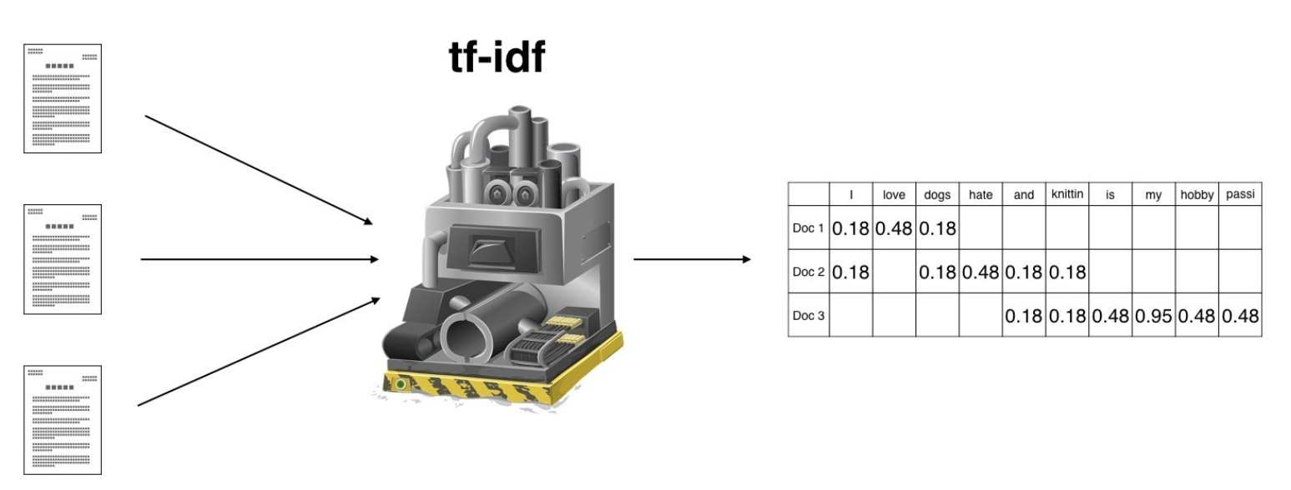

Slide 47

TF-IDF model
Suppose we want to mine the business reviews of people on Yelp.

Slide 48
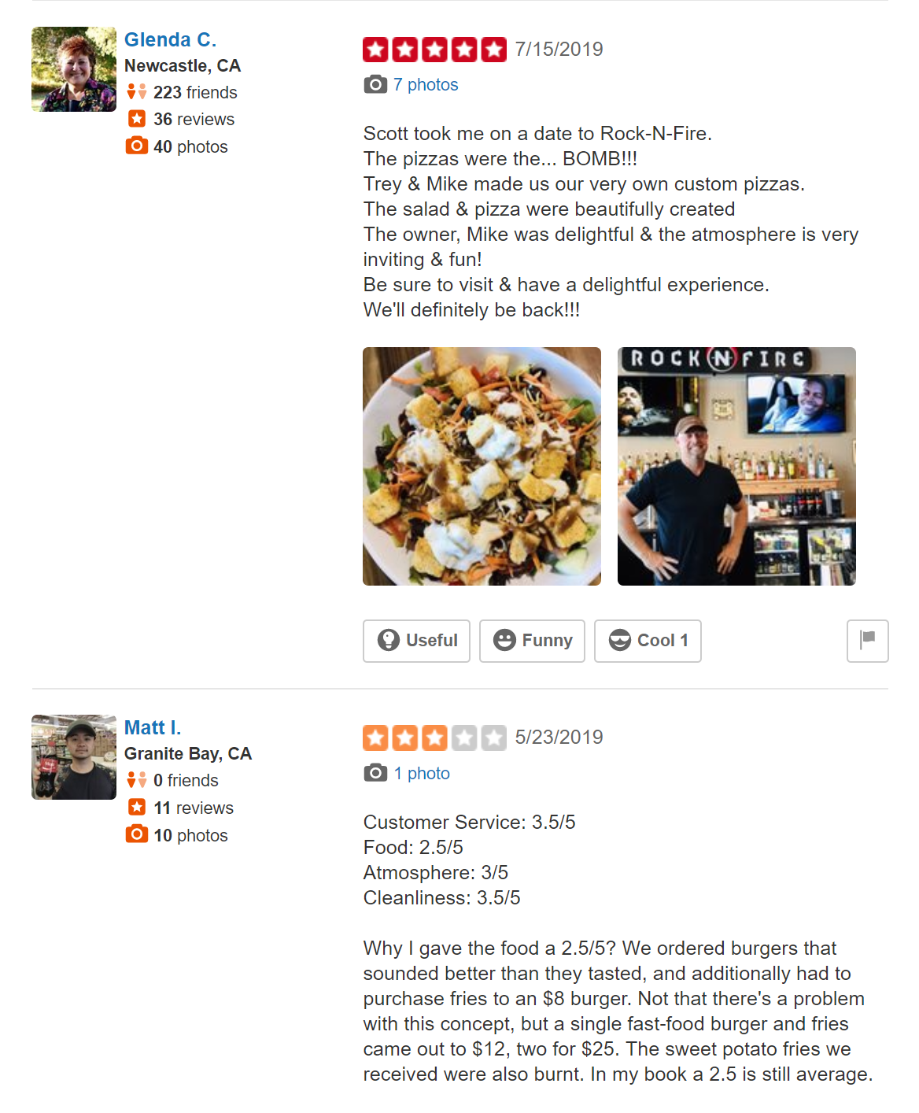
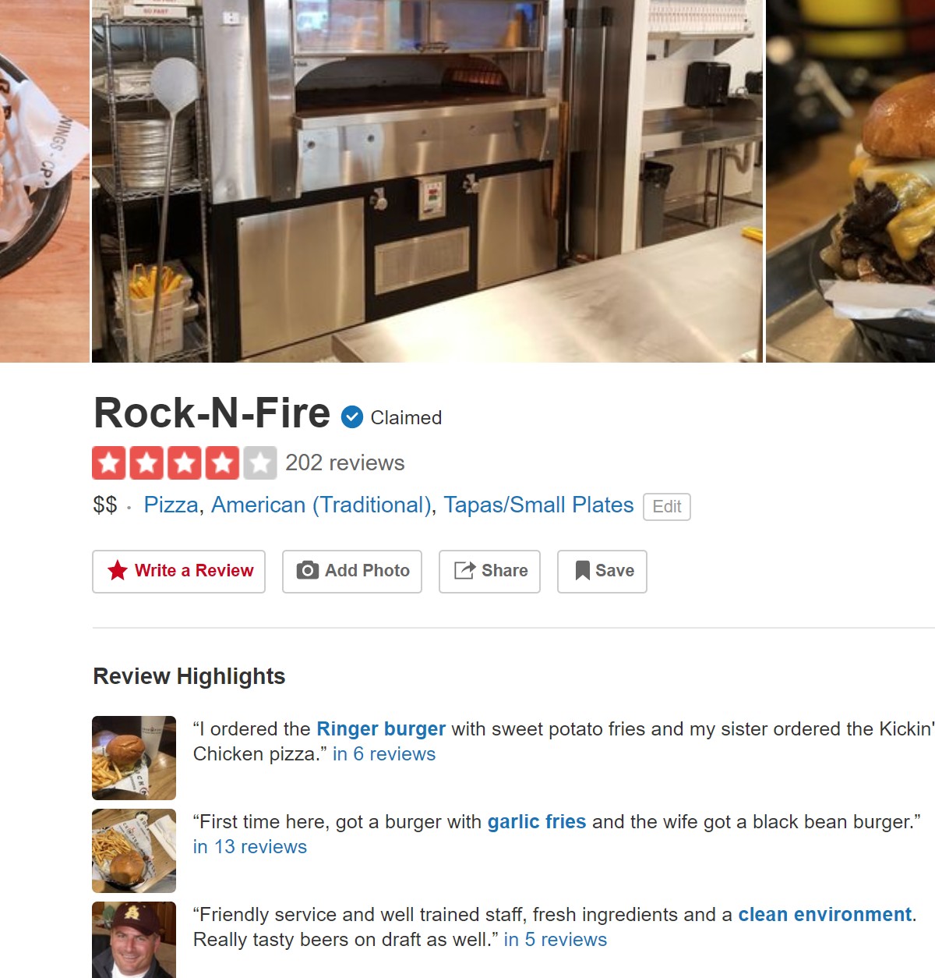
Yelp screenshots

Slide 49
Data collection
Collect all reviews for restaurants in NY in Yelp
Yelp API gives you each review in JSON format
https://www.yelp.com/developers
{"votes": {"funny": 0, "useful": 2, "cool": 1},
"user_id": "Xqd0DzHaiyRqVH3WRG7hzg",
"review_id": "15SdjuK7DmYqUAj6rjGowg",
"stars": 5, "date": "2007-05-17",
"text": "I heard so many good things about this place so I was pretty juiced to try it. I'm from Cali and I heard Shake Shack is comparable to IN-N-OUT and I gotta say, Shake Shake wins hands down. Surprisingly, the line was short and we waited about 10 MIN. to order. I ordered a regular cheeseburger, fries and a black/white shake. So yummerz. I love the location too! It's in the middle of the city and the view is breathtaking. Definitely one of my favorite places to eat in NYC.",
"type": "review",
"business_id": "vcNAWiLM4dR7D2nwwJ7nCA"}

Slide 50
Flat text data (one file per business)
I heard so many good things about this place so I was pretty juiced to try it. I'm from Cali and I heard Shake Shack is comparable to IN-N-OUT and I gotta say, Shake Shake wins hands down. Surprisingly, the line was short and we waited about 10 MIN. to order. I ordered a regular cheeseburger, fries and a black/white shake. So yummerz. I love the location too! It's in the middle of the city and the view is breathtaking. Definitely one of my favorite places to eat in NYC.
I'm from California and I must say, Shake Shack is better than IN-N-OUT, all day, err'day.
Would I pay $15+ for a burger here? No. But for the price point they are asking for, this is a definite bang for your buck (though for some, the opportunity cost of waiting in line might outweigh the cost savings) Thankfully, I came in before the lunch swarm descended and I ordered a shake shack (the special burger with the patty + fried cheese &amp; portabella topping) and a coffee milk shake. The beef patty was very juicy and snugly packed within a soft potato roll. On the downside, I could do without the fried portabella-thingy, as the crispy taste conflicted with the juicy, tender burger. How does shake shack compare with in-and-out or 5-guys? I say a very close tie, and I think it comes down to personal affliations. On the shake side, true to its name, the shake was well churned and very thick and luscious. The coffee flavor added a tangy taste and complemented the vanilla shake well. Situated in an open space in NYC, the open air sitting allows you to munch on your burger while watching people zoom by around the city. It's an oddly calming experience, or perhaps it was the food coma I was slowly falling into. Great place with food at a great price.

Slide 51
First cut
Remove punctuation, make into lower case, clear white spaces,
For each business, break into words, keep the most popular words
the 27514
and 14508
i 13088
a 12152
to 10672
of 8702
ramen 8518
was 8274
is 6835
it 6802
in 6402
for 6145
but 5254
that 4540
you 4366
with 4181
pork 4115
my 3841
this 3487
wait 3184
not 3016
we 2984
at 2980
on 2922
the 16710
and 9139
a 8583
i 8415
to 7003
in 5363
it 4606
of 4365
is 4340
burger 432
was 4070
for 3441
but 3284
shack 3278
shake 3172
that 3005
you 2985
my 2514
line 2389
this 2242
fries 2240
on 2204
are 2142
with 2095
the 16010
and 9504
i 7966
to 6524
a 6370
it 5169
of 5159
is 4519
sauce 4020
in 3951
this 3519
was 3453
for 3327
you 3220
that 2769
but 2590
food 2497
on 2350
my 2311
cart 2236
chicken 2220
with 2195
rice 2049
so 1825
the 14241
and 8237
a 8182
i 7001
to 6727
of 4874
you 4515
it 4308
is 4016
was 3791
pastrami 3748
in 3508
for 3424
sandwich 2928
that 2728
but 2715
on 2247
this 2099
my 2064
with 2040
not 1655
your 1622
so 1610
have 1585
What can you observe?

Slide 52
First cut
Remove punctuation, make into lower case, clear white spaces,
For each business, break into words, keep the most popular words
the 27514
and 14508
i 13088
a 12152
to 10672
of 8702
ramen 8518
was 8274
is 6835
it 6802
in 6402
for 6145
but 5254
that 4540
you 4366
with 4181
pork 4115
my 3841
this 3487
wait 3184
not 3016
we 2984
at 2980
on 2922
the 16710
and 9139
a 8583
i 8415
to 7003
in 5363
it 4606
of 4365
is 4340
burger 432
was 4070
for 3441
but 3284
shack 3278
shake 3172
that 3005
you 2985
my 2514
line 2389
this 2242
fries 2240
on 2204
are 2142
with 2095
the 16010
and 9504
i 7966
to 6524
a 6370
it 5169
of 5159
is 4519
sauce 4020
in 3951
this 3519
was 3453
for 3327
you 3220
that 2769
but 2590
food 2497
on 2350
my 2311
cart 2236
chicken 2220
with 2195
rice 2049
so 1825
the 14241
and 8237
a 8182
i 7001
to 6727
of 4874
you 4515
it 4308
is 4016
was 3791
pastrami 3748
in 3508
for 3424
sandwich 2928
that 2728
but 2715
on 2247
this 2099
my 2064
with 2040
not 1655
your 1622
so 1610
have 1585
Most frequent words are stop words

Slide 53
Second cut
After removing stop words…
ramen 8572
pork 4152
wait 3195
good 2867
place 2361
noodles 2279
ippudo 2261
buns 2251
broth 2041
like 1902
just 1896
get 1641
time 1613
one 1460
really 1437
go 1366
food 1296
bowl 1272
can 1256
great 1172
best 1167
burger 4340
shack 3291
shake 3221
line 2397
fries 2260
good 1920
burgers 1643
wait 1508
just 1412
cheese 1307
like 1204
food 1175
get 1162
place 1159
one 1118
long 1013
go 995
time 951
park 887
can 860
best 849
sauce 4023
food 2507
cart 2239
chicken 2238
rice 2052
hot 1835
white 1782
line 1755
good 1629
lamb 1422
halal 1343
just 1338
get 1332
one 1222
like 1096
place 1052
go 965
can 878
night 832
time 794
long 792
people 790
pastrami 3782
sandwich 2934
place 1480
good 1341
get 1251
katz's 1223
just 1214
like 1207
meat 1168
one 1071
deli 984
best 965
go 961
ticket 955
food 896
sandwiches 813
can 812
beef 768
order 720
pickles 699
time 662
What can you observe?

Slide 54
Second cut
After removing stop words…
ramen 8572
pork 4152
wait 3195
good 2867
place 2361
noodles 2279
ippudo 2261
buns 2251
broth 2041
like 1902
just 1896
get 1641
time 1613
one 1460
really 1437
go 1366
food 1296
bowl 1272
can 1256
great 1172
best 1167
burger 4340
shack 3291
shake 3221
line 2397
fries 2260
good 1920
burgers 1643
wait 1508
just 1412
cheese 1307
like 1204
food 1175
get 1162
place 1159
one 1118
long 1013
go 995
time 951
park 887
can 860
best 849
sauce 4023
food 2507
cart 2239
chicken 2238
rice 2052
hot 1835
white 1782
line 1755
good 1629
lamb 1422
halal 1343
just 1338
get 1332
one 1222
like 1096
place 1052
go 965
can 878
night 832
time 794
long 792
people 790
pastrami 3782
sandwich 2934
place 1480
good 1341
get 1251
katz's 1223
just 1214
like 1207
meat 1168
one 1071
deli 984
best 965
go 961
ticket 955
food 896
sandwiches 813
can 812
beef 768
order 720
pickles 699
time 662
Commonly used words in reviews, not so interesting

Slide 55
Importance measure: Term Frequency (TF)
TF(w,d): term frequency of word w in document d
A measure of importance of a word w for a document d
TF(w,d): = (Number of times w appears in d) / (Total number of terms in d).

Slide 56
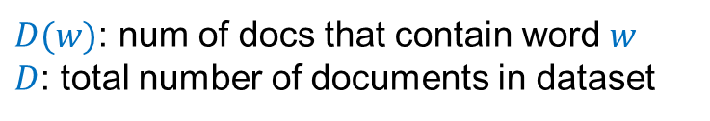
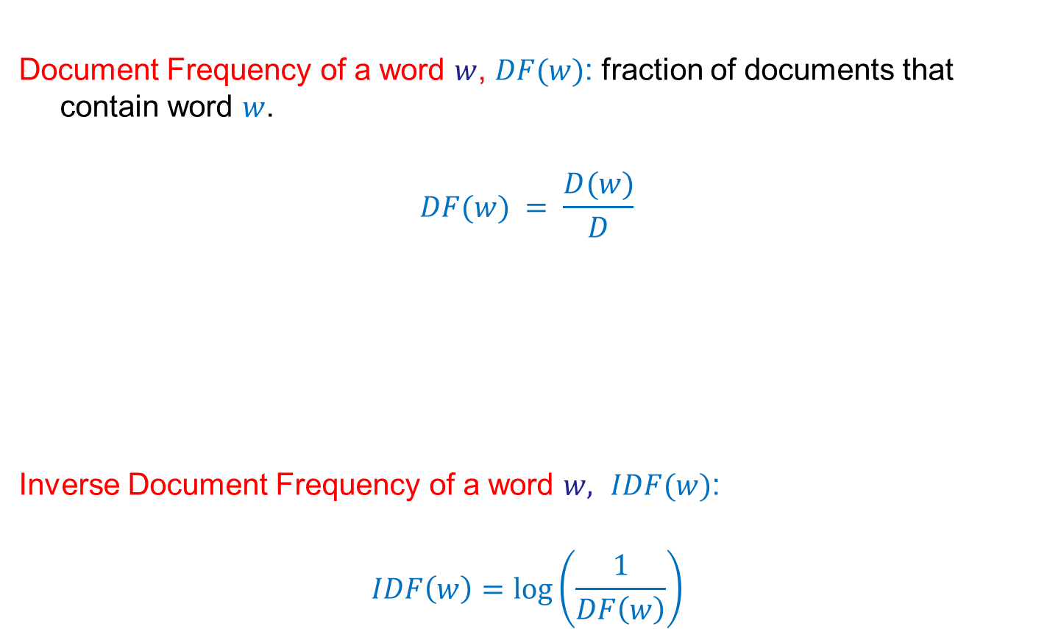
Uniqueness measure: Inverse Document Frequency (IDF)
Document Frequency of a word $w$, $DF(w)$: fraction of documents that contain word $w$.
$$DF(w) = \frac{D(w)}{D}$$
Inverse Document Frequency of a word $w,$ $IDF(w)$:
$$IDF\left(w\right)=\log\left(\frac{1}{DF\left(w\right)}\right)$$
$D(w)$: num of docs that contain word $w$
$D$: total number of documents in dataset

Slide 57
TF-IDF
For document analysis, we are more interested in the words that are not only important for the document, but also unique to the document.
TF(w,d): term frequency of word w in document d
A measure of importance of the word w for the document d
IDF(w): inverse document frequency
A measure of the uniqueness of the word w
TF-IDF(w,d) = TF(w,d) × IDF(w)

Slide 58
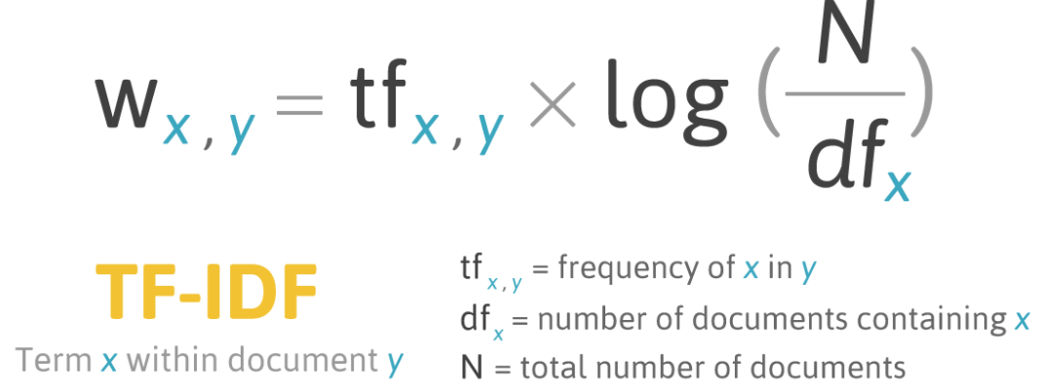
TF-IDF: put everything together

Slide 59
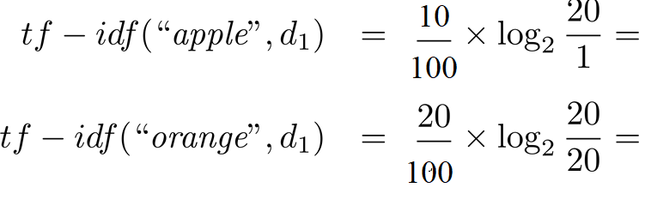
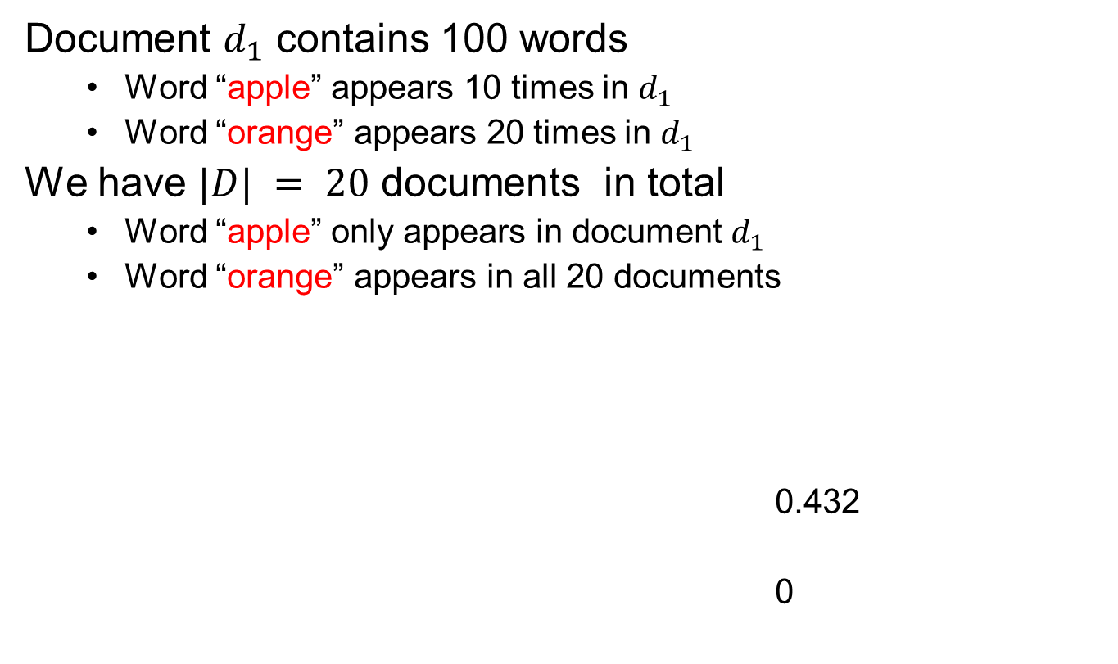
TF-IDF: An Example
Document $d_{1}$ contains 100 words
Word “apple” appears 10 times in $d_{1}$
Word “orange” appears 20 times in $d_{1}$
We have $|D| = 20$ documents in total
Word “apple” only appears in document $d_{1}$
Word “orange” appears in all 20 documents
0.432
0

Slide 60

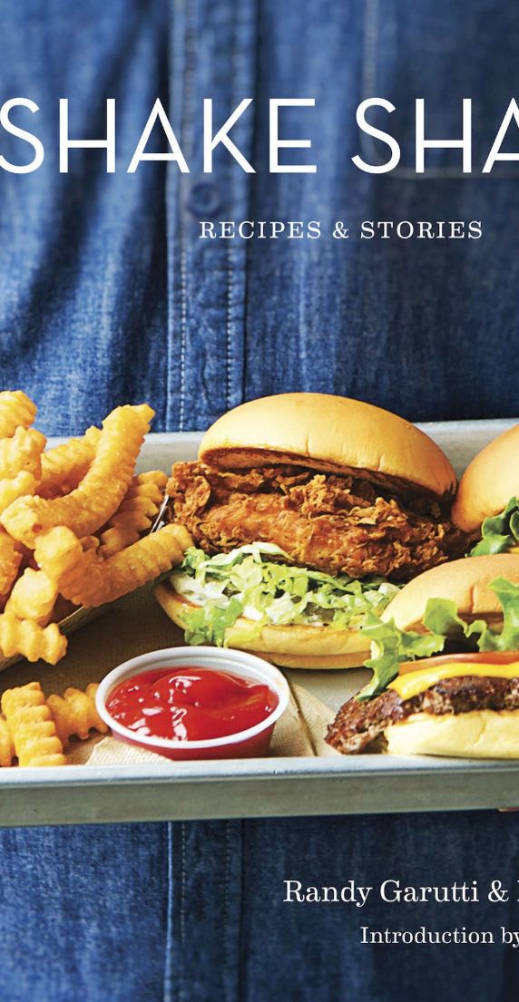
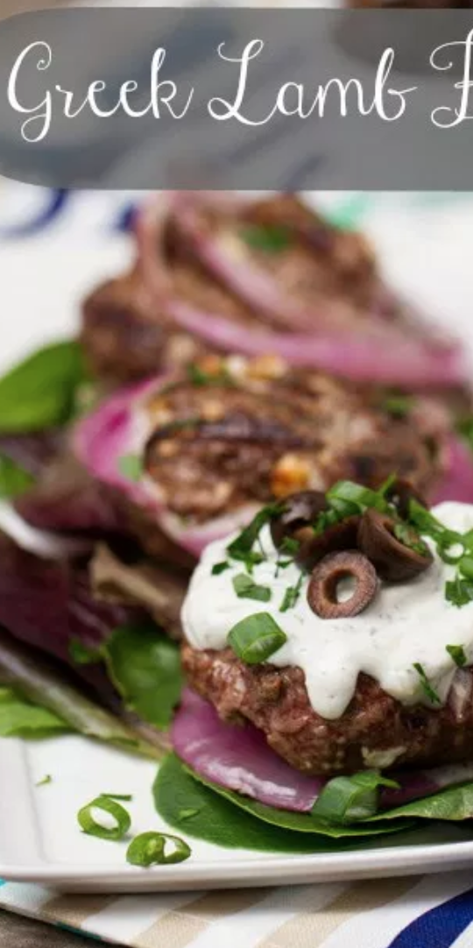
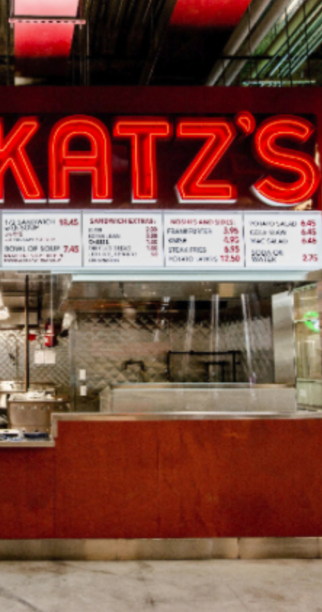
Third cut
Order all the words by TF-IDF per document
ramen 3057.41761944282 7
akamaru 2353.24196503991 1
noodles 1579.68242449612 5
broth 1414.71339552285 5
miso 1252.60629058876 1
hirata 709.196208642166 1
hakata 591.76436889947 1
shiromaru 587.1591987134 1
noodle 581.844614740089 4
tonkotsu 529.594571388631 1
ippudo 504.527569521429 8
buns 502.296134008287 8
ippudo's 453.609263319827 1
modern 394.839162940177 7
egg 367.368005696771 5
shoyu 352.295519228089 1
chashu 347.690349042101 1
karaka 336.177423577131 1
kakuni 276.310211159286 1
ramens 262.494700601321 1
bun 236.512263803654 6
wasabi 232.366751234906 3
dama 221.048168927428 1
brulee 201.179739054263 2
fries 806.085373301536 7
custard 729.607519421517 3
shakes 628.473803858139 3
shroom 515.779060830666 1
burger 457.264637954966 9
crinkle 398.34722108797 1
burgers 366.624854809247 8
madison 350.939350307801 4
shackburger 292.428306810 1
'shroom 287.823136624256 1
portobello 239.8062489526 2
custards 211.837828555452 1
concrete 195.169925889195 4
bun 186.962178298353 6
milkshakes 174.9964670675 1
concretes 165.786126695571 1
portabello 163.4835416025 1
shack's 159.334353330976 2
patty 152.226035882265 6
ss 149.668031044613 1
patties 148.068287943937 2
cam 105.949606780682 3
milkshake 103.9720770839 5
lamps 99.011158998744 1
lamb 985.655290756243 5
halal 686.038812717726 6
53rd 375.685771863491 5
gyro 305.809092298788 3
pita 304.984759446376 5
cart 235.902194557873 9
platter 139.459903080044 7
chicken/lamb 135.8525204 1
carts 120.274374158359 8
hilton 84.2987473324223 4
lamb/chicken 82.8930633 1
yogurt 70.0078652365545 5
52nd 67.5963923222322 2
6th 60.7930175345658 9
4am 55.4517744447956 5
yellow 54.4470265206673 8
tzatziki 52.9594571388631 1
lettuce 51.3230168022683 8
sammy's 50.656872045869 1
sw 50.5668577816893 3
platters 49.9065970003161 5
falafel 49.4796995212044 4
sober 49.2211422635451 7
moma 48.1589121730374 3
pastrami 1931.94250908298 6
katz's 1120.62356508209 4
rye 1004.28925735888 2
corned 906.113544700399 2
pickles 640.487221580035 4
reuben 515.779060830666 1
matzo 430.583412389887 1
sally 428.110484707471 2
harry 226.323810772916 4
mustard 216.079238853014 6
cutter 209.535243462458 1
carnegie 198.655512713779 3
katz 194.387844446609 7
knish 184.206807439524 1
sandwiches 181.415707218 8
brisket 131.945865389878 4
fries 131.613054313392 7
salami 127.621117258549 3
knishes 124.339595021678 1
delicatessen 117.488967607 2
deli's 117.431839742696 1
carver 115.129254649702 1
brown's 109.441778045519 2
matzoh 108.22149937072 1

Slide 61
Done!
Now, we get the TF-IDF vector for each document (restaurant), which are ready to be sent to models as input

Slide 62

Modeling and evaluation

Slide 63
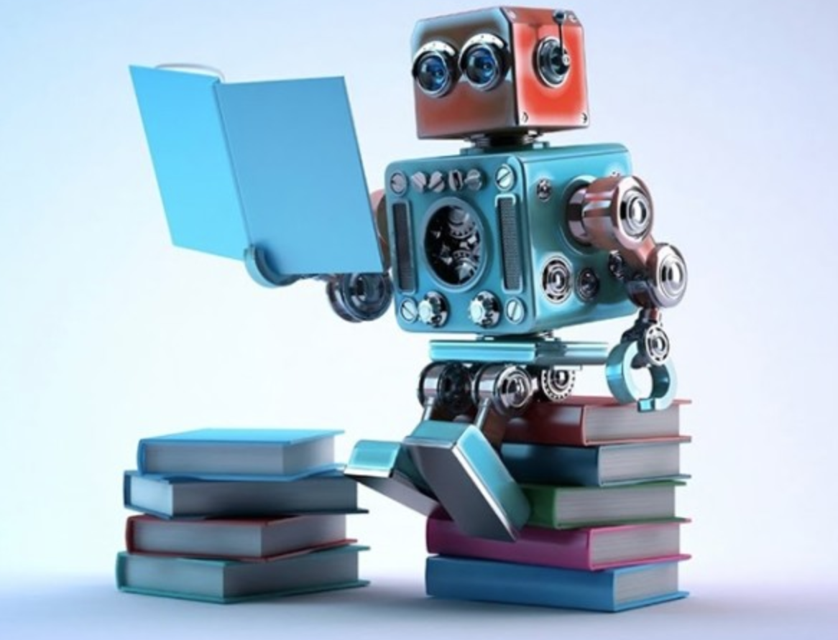
Machine learning
A study on getting a computer to finish a task without explicitly programming it

Slide 64
Learning types
Unsupervised (data has no labels)
Supervised (all data are labeled)

Slide 65
Machine Learning in a nutshell
 | Supervised Learning | Unsupervised Learning
Continuous Output | Regression (linear regression, neural networks,…) | Dimensionality reduction
Discrete Output | Classification (KNN, SVM, decision tree, Bayes classifier, logistic regression, neural networks…) | Clustering (k-means, hierarchical clustering, DBSCAN, GMM…)

Slide 66
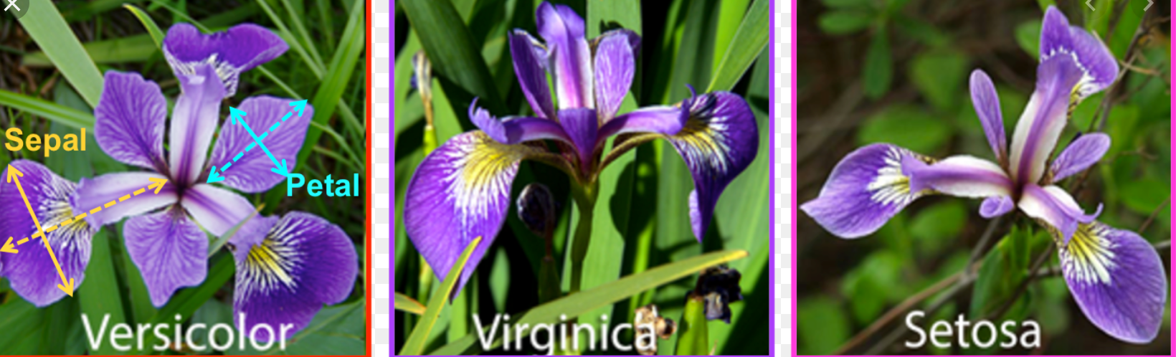
Classification
Learn a model from labeled data and make prediction on labels.
Predict the species of Iris flower (setosa, virginica and versicolor)

Slide 67
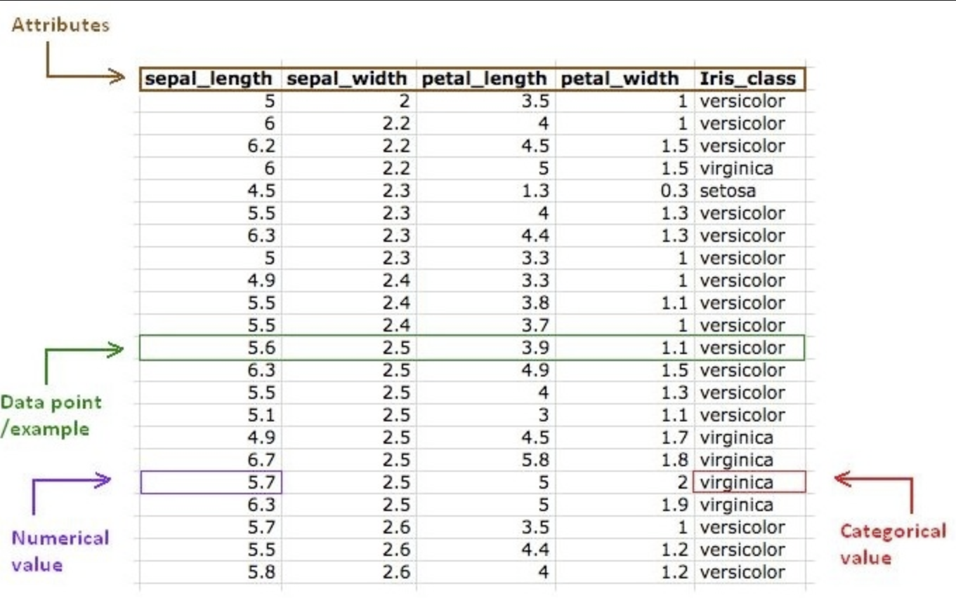
Classification

Slide 68
Steps in classification
Define the problem
What you are trying to predict?
Identify input features
Find the features that help to discriminate between the classes
Identify output labels
Decide on which model to train
What is the right model for your problem?
Train the model on training data
Test the model on test data

Slide 69
Any model
y = f_{Θ}(x)
Output(label)
function
Input (features)

Slide 70

Collecting data for computer vision
apple
pear
tomato
cow
dog
horse

Slide 71
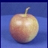
Machine learning pipeline
Learning
Training Labels
Training Samples
Features
Training
y = f_{Θ}(x)
Inference
Features
y = f_{Θ}( )
y = apple
Test Sample

Slide 72
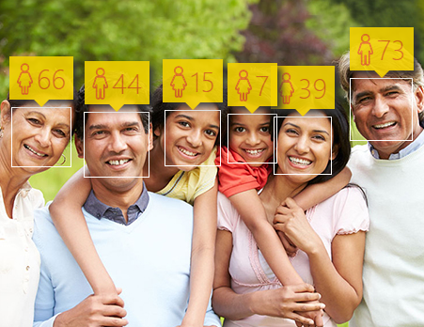
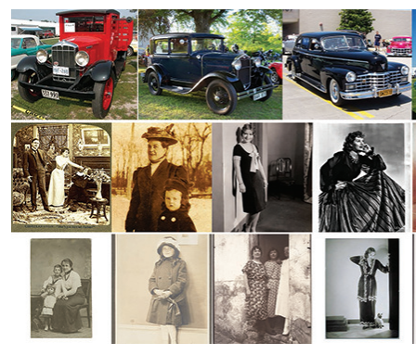
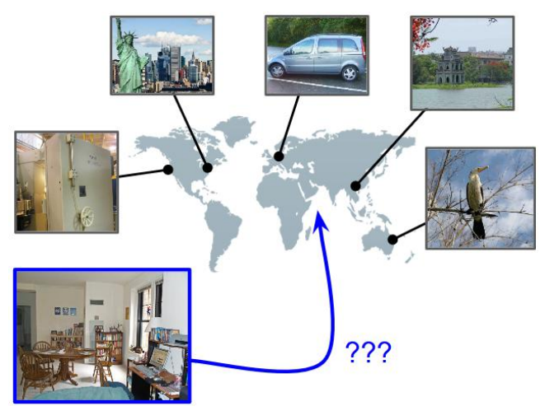
Regression
Age estimation
When was that made?
IM2GPS

Slide 73

Model evaluation
Split data into two separate parts
Learn parameters on the training set
Evaluate performance on the test set
~70% of records used for training, ~30% for testing

Slide 74
ML model evaluation
The ultimate goal of evaluation should be:
MAXIMIZE the ability of the model to predict new (out-of-sample) data.

Slide 75

Underfitting and Overfitting
Underfitting
Overfitting
Underfitting: when model is too simple, both training and test errors are large
Overfitting: when model is too complex it models the details of the training set and fails to generalize well on the test set

Slide 76

Underfitting and Overfitting

Slide 77
How to avoid underfitting and overfitting?
Train model parameters on training set
Test model performance on test set
Stop training once the test error goes up!
What metrics should be used to measure test error?

Slide 78
Metric used to evaluate model on test data
Classification
Precision
Recall
F1-score
ROC curve
Regression
RMSE (Root Mean Squared Error)
R2 score

Slide 79
Precision, Recall, F1-score
Precision: Out of records labeled as positive, how many are actually positive?
Recall: How many positive records are labeled correctly?
F-measure (F1-score): It combines precision and recall and can be used as a single summary number for model quality

Slide 80

Confusion matrix (binary problem)
 | PREDICTED CLASS
ACTUAL CLASS |  | Class=No | Class=Yes
 | Class=No | a (TN) | b (FP)
 | Class=Yes | c (FN) | d (TP)

Slide 81

Confusion matrix
Confusion matrix about a model used to predict whether a tumor is malignant (NO) or benign (YES)

Slide 82

ROC Curve
ROC curve plots TPR (true positive rate) (on the y-axis) against FPR (false positive rate) (on the x-axis)
 | PREDICTED CLASS
ACTUAL CLASS |  | Class=No | Class=Yes
 | Class=No | a (TN) | b (FP)
 | Class=Yes | c (FN) | d (TP)
Notes:
TPR = sensitivity
FPR = 1- selectivity

Slide 83

Using ROC for Model Comparison
Area Under Curve (AUC) determines which models preforms best
Ideal: Area = 1
Random guess（= Diagonal line）:
Area = 0.5

Slide 84
Lecture 3 Neural networks
CS 180 – Intelligent Systems
Dr. Victor Chen
Fall 2022

Slide 85

Neural networks

Slide 86

Neural networks
Neural networks are collections of neurons.
One neuron is a weighted sum, followed by an activation function.

Slide 87


Neuron with sigmoid = Logistic regression
Input
Bias b
Weights
x₁
w₁
x₂
w₂
Output: σ(w⋅x + b)
x₃
w₃
.
.
.
Sigmoid function:
w_{d}
x_{d}

Slide 88
Neuron with linear function = Linear regression
Input
Bias b
Weights
x₁
w₁
x₂
w₂
Output: σ(w⋅x + b)
x₃
w₃
.
.
.
linear function:
w_{d}
x_{d}

Slide 89


Neuron with Tanh function

Slide 90
Neuron with ReLU function
Rectified linear unit (ReLU): σ(t) = max(0,t)

Slide 91

Model with two outputs
We can put two neurons in parallel

Slide 92

Model with three outputs
We can put three neurons in parallel

Slide 93


Softmax implementation
np.exp(x): Calculate the exponential of x

Slide 94

Softmax example
What is softmax([1, 2, 3])?
y1 = $\frac{{\text{e}}^{1 }}{{\text{e}}^{1 }+{\text{e}}^{2 }+{\text{e}}^{3 }}$ = 0.09
y2 = $\frac{{\text{e}}^{2 }}{{\text{e}}^{1 }+{\text{e}}^{2 }+{\text{e}}^{3 }}$ = 0.24
y3 = $\frac{{\text{e}}^{3 }}{{\text{e}}^{1 }+{\text{e}}^{2 }+{\text{e}}^{3 }}$= 0.67
Output vector:
[0.09, 0.24, 0.67]

Slide 95


Neutral Network for image classification
Build a multi-layer neural network! One output neuron for one class

Slide 96


Softmax
Softmax function is used to ensure that the model output will be a probabilistic distribution, i.e., it converts any given vector to a distribution.
setosa, versicolor, virginica?
0.09
0.24
0.67

Slide 97

Neutral network for language processing

Slide 98
Training of multi-layer networks
Goal: Find edge weights to minimize the error between “true” and “predicted” labels of training records:

Slide 99
Training of multi-layer networks
https://ml4a.github.io/demos/simple_forward_pass/

Slide 100
How to update model weights: gradient descent
Update weights by gradient descent:
α here is called learning rate.
Gradient update

Slide 101


Gradient descent

Slide 102

Back-propagation (gradient descent)
Gradient updates are computed in the direction from output to input layers.

Slide 103
Two key questions for back-propagation
How often the weights will be updated?
How the weights will be updated at each step?

Slide 104
How often weights are updated?
When you train a model, you need to specify how many samples you want to use per update. That is called batch size.
Online Training - Update the weights based on gradients from a single training record.
Vanilla Gradient Descent - Update the weights based on the gradients over all training records.
Batch Size Training- Update the weights at a time based on some batch size of training elements.
Mini-Batch Training - The same as batch size, but with a very small batch size. (Batch size defaults to 32 in Tensorflow/Keras).

Slide 105
Step v.s. Epoch
The batch size is smaller than the training data size, so it may take several batches to make it completely through the training set.
At each step (iteration), one batch was processed.
At each epoch, we went through the complete training set once. A single pass through the entire training set

Slide 106
How weights are updated per step?
Choose update rules (optimizers). There are a few variations of gradient descent you can choose from
TensorFlow allows the update rule to be set to one of:
Adam
Adagrad
Adadelta
Adamax
Momentum
Stochastic Gradient Descent (SGD)
Others
https://keras.io/optimizers/

Slide 107
Reflection on update rules (adaptive vs non-adaptive)
Each algorithm has its strengths and weaknesses.
For rapid prototyping, use adaptive techniques like Adam/Adagrad. These help in getting quicker results with much less efforts.
To get the best results, you should use Stochastic Gradient Descent (SGD). SGD is slow to get the desired results, but these results are mostly better than adaptive techniques.

Slide 108
Neural networks: pros and cons
Pros
Flexible and general function approximation framework
Can build extremely powerful models by adding more layers
Cons
Training is prone to local optimum.
Huge amount of training data, computing power required to get good performance
Implementation choices is huge (network architectures, parameters)

Slide 109

Gradient descent is prone to local optimum

Slide 110

Pay attention to learning rate
https://www.benfrederickson.com/numerical-optimization/

Slide 111
Demo of gradient descent
https://lukaszkujawa.github.io/gradient-descent.html

Slide 112
Neutral network for image captioning
http://destiny.liacs.nl/

Slide 113
Lecture 4 Deep Learning
CS 180 – Intelligent Systems
Dr. Victor Chen
Fall 2022

Slide 114

Deep learning gaining popularity

Slide 115

Deep learning today
https://experiments.withgoogle.com/collection/ai

Slide 116

Demo
https://quickdraw.withgoogle.com/
The model takes sequences of strokes as input.

Slide 117

Deep learning in a nutshell
“Regular" neural networks usually have
one to two hidden layers
are used for SUPERVISED learning.
“Deep” neural networks have
more hidden layers
can be used for both UNSUPERVISED and SUPERVISED learning.

Slide 118

Regular neural network (dense/fully-connect neural network)

Slide 119

A deep network for recognizing handwritten digits

Slide 120

Why deep learning is generally better?

Slide 121

Feature detection using deep learning
“The hidden layers” can (1) detect “true underlying” features and (2) train model on those features

Slide 122

Object detection example

Slide 123


Feature detectors

Slide 124
What is this neuron doing?

Slide 125
Hidden layer neurons become feature detectors
1 5 10 15 20 25 …
…
1
strong weight
low/zero weight
63

Slide 126
Hidden layer neurons become feature detectors
1 5 10 15 20 25 …
…
1
strong weight
low/zero weight
63

Slide 127
Hidden layer neurons become feature detectors
1 5 10 15 20 25 …
…
1
strong +ve weight
low/zero weight
it will send strong signal for a horizontal
line in the top row, ignoring everywhere else
63

Slide 128
Another neuron
1 5 10 15 20 25 …
…
1
strong weight
low/zero weight
63

Slide 129
Another neuron
1 5 10 15 20 25 …
…
1
strong weight
low/zero weight
Strong signal for a red area in the top left
corner
63

Slide 130
What features do you think would make a good model?

Slide 131
vertical lines
1
63

Slide 132
Horizontal lines
1
63

Slide 133
Small circles
1
63

Slide 134
Hidden neurons can detect for
specific parts of an image
63

Slide 135
Hidden neurons can detect for
specific parts of an image
But what about correlation among different parts?
63

Slide 136


Successive layers can learn higher-level features
detect lines in
specific positions
etc …
Higher level detectors
( horizontal line,
“vertical lune”
“circle”, etc…
etc …
v

Slide 137
Successive layers can learn higher-level features
detect lines in
Specific positions
etc …
Higher level detetors
( horizontal line,
“RHS vertical lune”
“upper loop”, etc…
etc …
v
What does this unit detect?

Slide 138
That is how multiple layers make sense

Slide 139

We want to stack many hidden layers to capture “true” features from lower levels to higher levels

Slide 140


Successive layers can learn higher-level features
Your brain works that way

Slide 141

Review
How to train a neural network?

Slide 142



-0.06
W1
W2
f(x)
-2.5
W3
1.4

Slide 143
-0.06
2.7
-8.6
f(x)
-2.5
0.002
-0.06×2.7 + 2.5×8.6 + 1.4×0.002 = 21.34
sigmoid(21.34) = 0.99
1.4

Slide 144

A dataset
Fields class
1.4 2.7 1.9 0
3.8 3.4 3.2 0
6.4 2.8 1.7 1
4.1 0.1 0.2 0
etc …

Slide 145
Training data
Fields class
1.4 2.7 1.9 0
3.8 3.4 3.2 0
6.4 2.8 1.7 1
4.1 0.1 0.2 0
etc …
Initialize model with random weights

Slide 146
Training data
Fields class
1.4 2.7 1.9 0
3.8 3.4 3.2 0
6.4 2.8 1.7 1
4.1 0.1 0.2 0
etc …
Present a training record
1.4
2.7
1.9

Slide 147
Training data
Fields class
1.4 2.7 1.9 0
3.8 3.4 3.2 0
6.4 2.8 1.7 1
4.1 0.1 0.2 0
etc …
Feed it through to get output
1.4
2.7 0.8
1.9

Slide 148
Training data
Fields class
1.4 2.7 1.9 0
3.8 3.4 3.2 0
6.4 2.8 1.7 1
4.1 0.1 0.2 0
etc …
Compare with target output
1.4
2.7 0.8
0
1.9 error 0.8

Slide 149


Training data
Fields class
1.4 2.7 1.9 0
3.8 3.4 3.2 0
6.4 2.8 1.7 1
4.1 0.1 0.2 0
etc …
Adjust weights based on error
(gradient descent)
1.4
2.7 0.8
0
1.9 error 0.8

Slide 150
Training data
Fields class
1.4 2.7 1.9 0
3.8 3.4 3.2 0
6.4 2.8 1.7 1
4.1 0.1 0.2 0
etc …
Present a training pattern
6.4
2.8
1.7

Slide 151
Training data
Fields class
1.4 2.7 1.9 0
3.8 3.4 3.2 0
6.4 2.8 1.7 1
4.1 0.1 0.2 0
etc …
Feed it through to get output
6.4
2.8 0.9
1.7

Slide 152
Training data
Fields class
1.4 2.7 1.9 0
3.8 3.4 3.2 0
6.4 2.8 1.7 1
4.1 0.1 0.2 0
etc …
Compare with target output
6.4
2.8 0.9
1.7 error -0.1

Slide 153
Training data
Fields class
1.4 2.7 1.9 0
3.8 3.4 3.2 0
6.4 2.8 1.7 1
4.1 0.1 0.2 0
etc …
Adjust weights based on error
6.4
2.8 0.9
1.7 error -0.1

Slide 154
Training data
Fields class
1.4 2.7 1.9 0
3.8 3.4 3.2 0
6.4 2.8 1.7 1
4.1 0.1 0.2 0
etc …
And so on ….
6.4
2.8 0.9
1.7 error -0.1
Repeat this THOUSANDS, MAYBE MILLIONS OF TIMES – each time taking a RANDOM training record, and making slight weight adjustments

Slide 155
The decision boundary perspective…
Initial random weights

Slide 156
The decision boundary perspective…
Present a training instance / adjust the weights

Slide 157
The decision boundary perspective…
Present a training instance / adjust the weights

Slide 158
The decision boundary perspective…
Present a training instance / adjust the weights

Slide 159
The decision boundary perspective…
Present a training instance / adjust the weights

Slide 160
The decision boundary perspective…
Eventually ….

Slide 161
Now we have a new way to train a very deep neural networks…
In the past, we rarely use a very deep network

Slide 162
The new way to train multi-layer NNs…
Train this layer first

Slide 163
The new way to train multi-layer NNs…
Train this layer first
then this layer

Slide 164
The new way to train multi-layer NNs…
Train this layer first
then this layer
then this layer

Slide 165
The new way to train multi-layer NNs…
Train this layer first
then this layer
then this layer
then this layer

Slide 166
The new way to train multi-layer NNs…
Train this layer first
then this layer
then this layer
then this layer
finally this layer

Slide 167
The new way to train multi-layer NNs…
EACH of non-output layers is trained to be an auto-encoder

Slide 168

Auto-encoder is a neural network with the output layer having the same number of neurons as the input layer.
Auto-encoder

Slide 169
Auto-encoder
The purpose of using Auto-encoder is to reconstruct (recover) its input (X).
We want the output to be as close to input as possible

Slide 170

Why Auto-encoder can learn “true” features?
The ‘middle hidden layer’ has fewer neurons than the inputs.
Compress input data into a short code in such a way that when we uncompress that code, we can get input recovered.
The output from the ‘middle hidden layer’ are “true” features (embedding of the input).
This process forces ‘middle hidden layer’ to become good feature detectors for input
This process can also be referred to dimensionality reduction.

Slide 171
Popular deep learning architectures
Convolutional Neural Networks
Scenarios where spatially-closer data are more correlated
Recurrent Neural Networks
Data with temporal or sequential structures

Slide 172
Popular deep learning architectures
Convolutional Neural Networks
Scenarios where spatially-closer data are more correlated
Recurrent Neural Networks
Data with temporal or sequential structures

Slide 173

Convolutional Neural Network (CNN)
In CNNs, hidden neurons are only connected to local receptive field.
The number of weights (parameters) in CNNs is much smaller than a fully-connected neural network.
CNN is widely used in computer vision.
Example: 200x200 image
A fully connected layer: 40,000 input units X 40,000 hidden units => 1.6 billion connections (parameters)
A CNN layer: 5x5 kernel, 100 kernel => 2,600 parameters

Slide 174

Three Stages of A Convolutional Operation
Convolution
Nonlinear transformation
Pooling

Slide 175


Convolution stage
Input: an image x (2-D array) x
Convolution kernel (2-D array of learnable parameters): w
Output: called feature map (2-D array of processed data): s
Convolution operation:

Slide 176

Single Convolution Kernel

Slide 177

Multiple Convolution Kernels
Multiple convolution kernels yield multiple feature maps, one for each kernel.

Slide 178
Multiple Convolution Kernels
In TesorFlow, you should provide the following parameters to define each convolutional layer:
Number of filters/kernels
Kernel size (vertical, horizontal): the height and width of convolution window
Strides (vertical, horizontal): default strides=(1, 1)

Slide 179
Demo of multiple kernels
http://setosa.io/ev/image-kernels/

Slide 180




Nonlinear transformation
Tanh(x)
ReLU
$$\tanh\left(x\right)= \frac{e^{x}−e^{−x}}{e^{x}+e^{−x}}$$
$$f\left(x\right)=max⁡(0, x)$$

Slide 181


Pooling (downsampling strategy)
Common pooling operations:
Max pooling: reports the maximum output within a rectangular neighborhood.
Average pooling: reports the average output of a rectangular neighborhood.
Pool size (vertical, horizontal)
Stride value (vertical, horizontal)
Padding: "valid" or "same"

Slide 182

Each CNN operation (Conv + Nonlinear + Pooling)

Slide 183
Video on CNN

Slide 184
Note on CNN
You may use multiple convolution kernels (hidden neurons), which give you multiple feature maps.
You may stack multiple convolutional layers for extracting features at different levels.
Higher-level layers take the feature maps from lower-level layers as input.

Slide 185




Deep CNN
CNN extracts features automatically through multiple layers.
Low-level features
Mid-level features
High-level features
Trainable classifier
output

Slide 186

CNN for RGB Image Classification

Slide 187



CNN in Alpha-Go
A CNN with 13 layers
Input board position as image $s$
Output: $p_{σ} (a|s)$, where$a$ is the next move

Slide 188
CNN for Image Classification
https://cs.stanford.edu/people/karpathy/convnetjs/

Slide 189
CNN talks
NVIDIA’s CES talk about their self-driving cars
YOLO

Slide 190
Lecture 5 Transfer Learning and GAN
CS 180 – Intelligent Systems
Dr. Victor Chen
Fall 2022

Slide 191

Transfer learning
A large amount of data is required to train good deep learning models
What if you don't have much data on your own task?

Slide 192

Transfer learning

Slide 193

Transfer learning
If you don't have much data on your own task, find a similar task with much data and use transfer learning
In transfer learning, we reuse a model trained on one task for another task.

Slide 194

Two basic steps in transfer learning:
Identify a pre-trained model on a different but similar task.
Fine-tune the pre-trained model using your own data.
We refine the pre-trained model to make sure it works for your exact problem

Slide 195

Transfer learning video

Slide 196
How to find pre-trained models
Many research institutions release models pre-trained on large datasets. These models took days or weeks to train on modern hardware.
Pre-trained models on image classification problem
Oxford VGG Model
Google Inception Model
Microsoft ResNet Model
Pre-trained models on natural language processing
Google’s word2vec Model
Doc2vec model
Stanford’s GloVe Model
ELMo
BERT

Slide 197
Pre-trained models in Tensorflow/Keras
https://keras.io/applications/
Models for image classification with weights trained on ImageNet (http://image-net.org/index):
Xception
VGG16
VGG19
ResNet, ResNetV2, ResNeXt
InceptionV3
InceptionResNetV2
MobileNet
MobileNetV2
DenseNet
NASNet

Slide 198

Transfer learning in Tensorflow
Step 1: Load a pre-trained model (except the top layer)

Slide 199

Transfer learning in Tensorflow
Step 2: Fix the weights from the pre-trained model

Slide 200

Transfer learning in Tensorflow
Step 3: Add other layers on top of the pre-trained model

Slide 201
Takeaway
Transfer learning is a shortcut to saving time or getting better performance
Use transfer learning if
You don't have much data on your own task but you can identify a related task and there is a pre-trained model available for that task.
Use transfer learning for your final project, which will boost the model performance and save training time

Slide 202
GAN (Generative Adversarial Networks)
Discriminative algorithms try to classify input data; that is, given the features of an instance of data, they predict a label or category to which that data belongs.
Generative algorithms generate new, synthetic data that mimic real data. They are used in image generation, video generation and voice generation.
While discriminative models care about the relation between y and x, generative models care about “how you get x.”

Slide 203

GAN(Generative Adversarial Networks)

Slide 204
GAN Video

Slide 205
DeepFake
https://www.cnn.com/interactive/2019/01/business/pentagons-race-against-deepfakes/

Slide 206
The Next Rembrandt
www.nextrembrandt.com

